Slide 1




Notes:
The use of electronic smoking products (or ESPs) has grown quickly over the last three years. That’s why it is more important than ever that youth understand the difference between how these products are advertised and what we actually know about them.
Ask youth what they know about ESPs before you start the presentation.

Slide 2
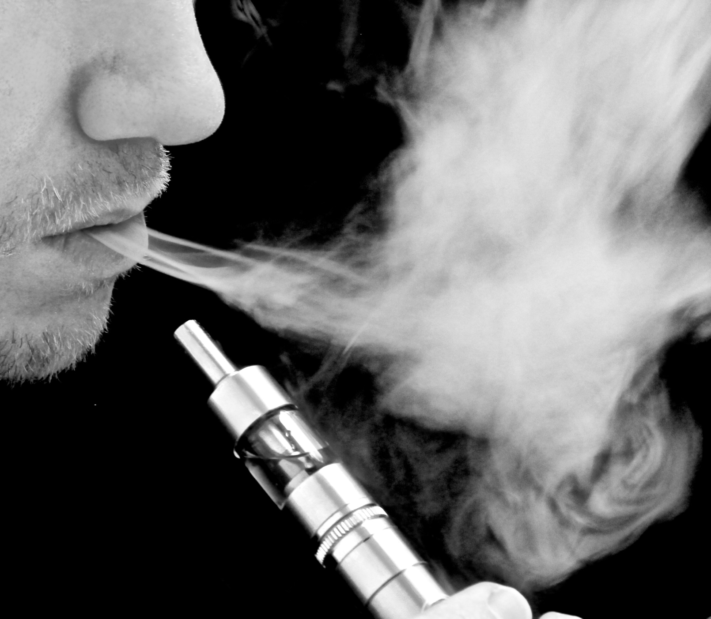
ESPs are battery-operated devices that contain cartridges filled with liquid chemicals.
The chemicals turn into a vapour that the user inhales (this is called vaping).
They do not contain tobacco.
They can look like a cigarette,
a pen or many other objects.
Notes:
Ask youth if they have seen or heard of many people who use ESPs.

Slide 3


Electronic cigarettes
E-cigs
Electronic smoking devices
E-cigars
Personal vaporizers (PVs)
E-gars
Nicotine vaporizers
E-pipes
Hookah pens
E-fags
E-hookahs
Mods
Vape pens
Notes:
Ask the youth which of these terms they have heard used most commonly.

Slide 4
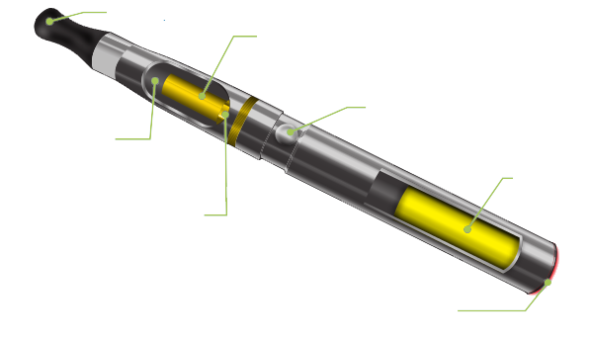
Mouthpiece
Heating element/Atomizer heats the “juice” to make vapour.
Many devices have a switch to activate the heating element.
Cartridge (tank) holds the liquid “juice”.
Battery
Microprocessor
Some devices have a light-emitting diode on the end to simulate the glow of a burning cigarette.

Slide 5
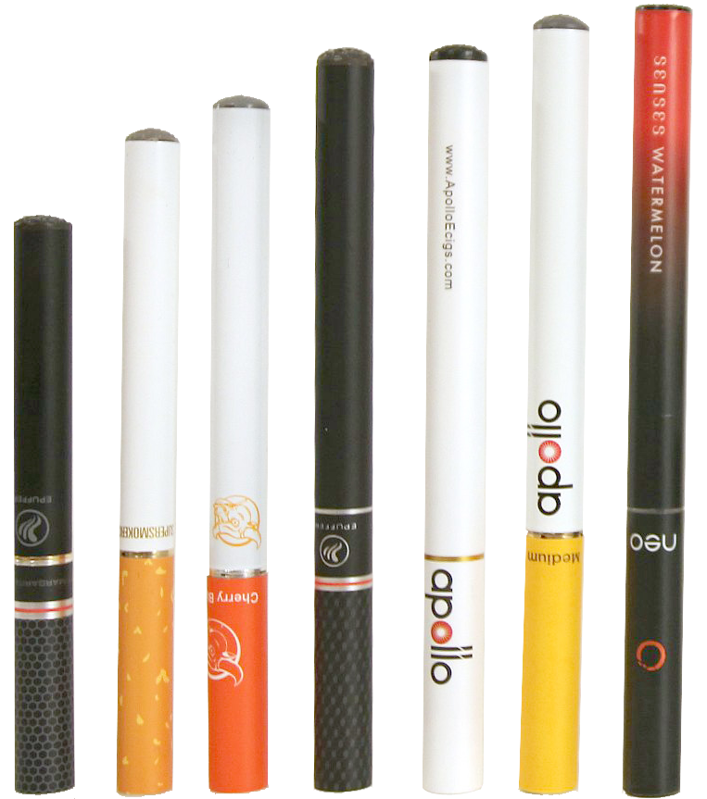

Early e-cigarettes were
made to look like cigarettes.
They were either disposable, or came with rechargeable lithium batteries.
These ESPs were linked to many cases of explosions and fires.
Notes:
Prices varied widely, depending on what features the ESP come with, if it is rechargeable or disposable, etc.
Can be sold individually, or in larger packs.
Explosions and fire more likely due to
the shape and structure of the cylindrical device
the placement of the battery within the cylinder
the lack of protection around the battery
the common USB charging port, which is compatible with non-certified chargers that can overcharge the battery
Sources:
Campaign for Tobacco-Free Kids. (n.d.). Electronic cigarettes: An overview of key issues. Retrieved from https://www.tobaccofreekids.org/research/factsheets/pdf/0379.pdf
Ecigarettereviewed. (n.d.). What is an e-cigarette? Retrieved from http://ecigarettereviewed.com/about-e-cigs
Lopez, A. A., & Eissenberg, T. (2015). Science and the evolving electronic cigarette. Preventive Medicine, 80, 101–106. Retrieved from http://www.sciencedirect.com/science/article/pii/S0091743515002224
U.S. Fire Administration. Electronic Cigarette Fires and Explosions (2014) https://www.usfa.fema.gov/downloads/pdf/publications/electronic_cigarettes.pdf

Slide 6
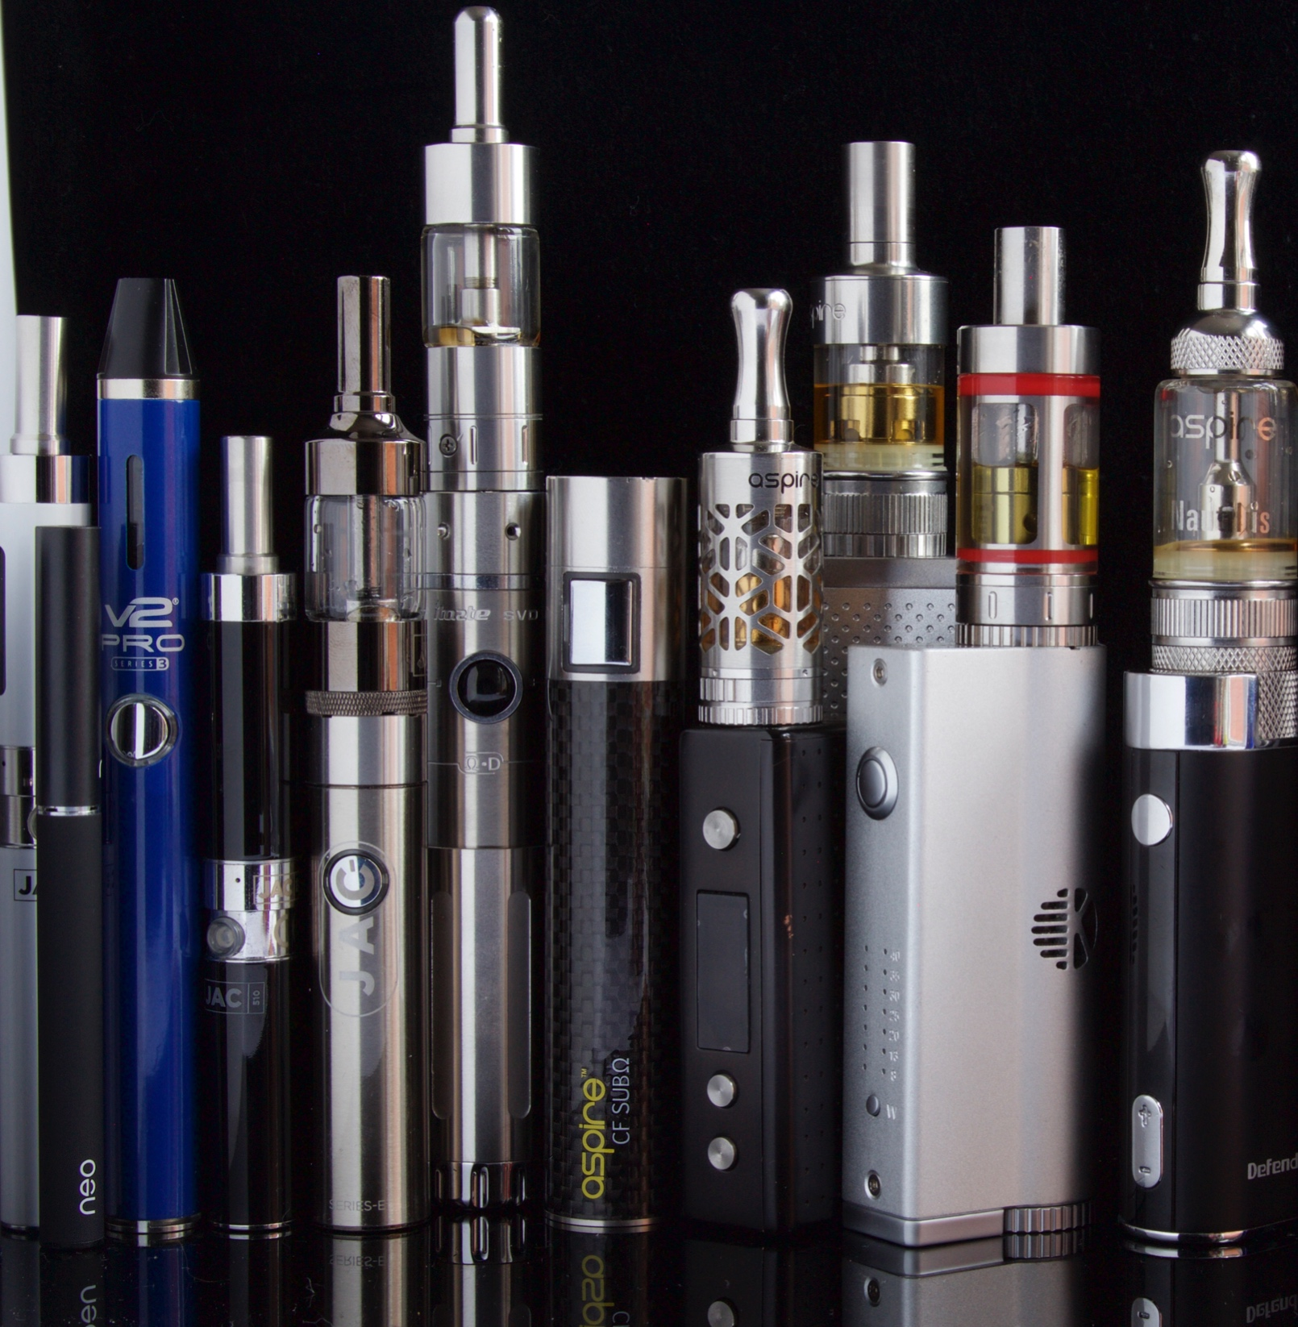
These come in many shapes and sizes and can look like anything from a screwdriver to a smartphone.
They come with many different types of batteries, tanks and atomizers.
Many parts can be mixed and matched to create a custom product.
These products are very expensive — up to $300 for the device, and much more for the accessories.
Notes:
Ask youth if they have seen these types of products, and what they looked like.
Discuss the expense of the product and how it adds up:
$300 for the base
$10 for batteries
$20 for a charger
$10–50 for the liquid (which lasts a few days or less)
Sources:
Morean, M. E., Kong, G., Camenga, D. R., Cavallo, D. A., & Krishan-Sarin, S. (2015). High school students’ use of electronic cigarettes to vaporize cannabis. Pediatrics, 136(4). Retrieved from http://pediatrics.aappublications.org/content/pediatrics/early/2015/09/01/peds.2015-1727.full.pdf
Neal, M. (2014, June 8). E-cigarettes don’t look anything like you think they do. Motherboard. Retrieved from http://motherboard.vice.com/read/e-cigarettes-dont-look-anything-like-you-think-they-do

Slide 7


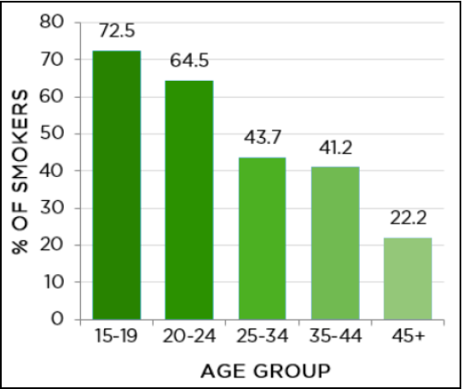
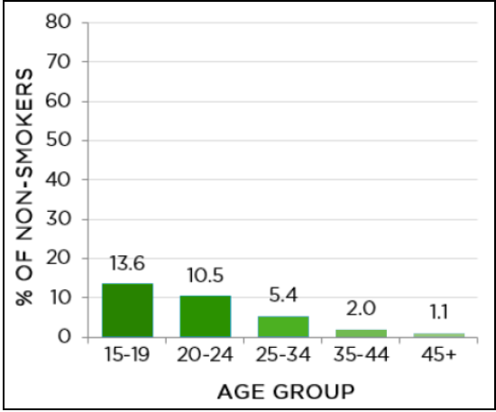
People who are younger, have higher educations, or have higher incomes.
Ever Use of E-cigarettes by Age Group Among Smokers, 2013
Ever Use of E-cigarettes by Age Group Among Non-Smokers, 2013
Data Source: CTADS, 2013
Data Source: CTADS, 2013
Notes:
40% of current and former smokers aged 18+ in Canada are aware of e-cigarettes, and 4% have tried them.
16% of young adults aged 16–30 in Canada have tried an e-cigarette, including 35% of smokers and 5% of non-smokers.
Rates of current use are much lower—15% of smokers and less than 1% of non-smokers.
In the U.S., the rate of high-school students who have ever used e-cigarettes has doubled, from 4.7% to 10.0%, from 2011 to 2012.
Rates of current e-cigarette use (past 30 days) in the U.S. increased from 1.5% to 2.8%.
Sources:
Government of Canada. (2015). Canadian tobacco, alcohol and drugs survey (CTADS): Summary of results for 2013. Retrieved from http://healthycanadians.gc.ca/science-research-sciences-recherches/data-donnees/ctads-ectad/summary-sommaire-2013-eng.php
Non-Smokers’ Rights Association. (2015). E-cigarettes: Understanding the potential risks and benefits. Retrieved from http://www.nsra-adnf.ca/cms/file/files/E-Cig_Fact_Sheet_29Apr15.pdf

Slide 8

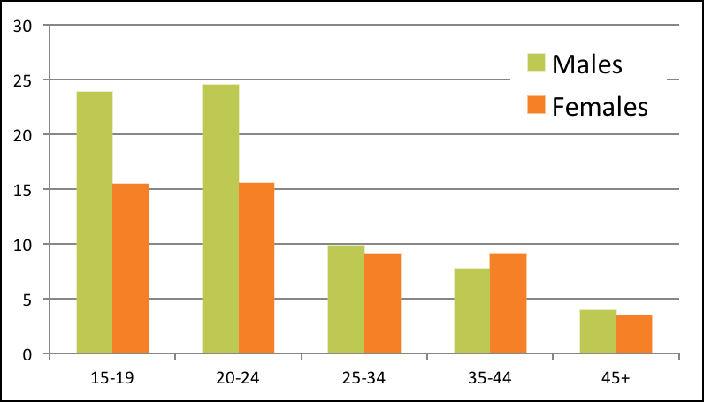
Percentage of E-cigarette Users by Gender, 2015
Notes:
Ask questions, such as:
Why do you think the rates are higher among males?
What do you think this means for Canada’s health statistics?
Do these numbers match your own experience?
Source:
Government of Canada. (2015). Canadian tobacco, alcohol and drugs survey (CTADS): Summary of results for 2013. Retrieved from http://healthycanadians.gc.ca/science-research-sciences-recherches/data-donnees/ctads-ectad/summary-sommaire-2013-eng.php

Slide 9

20%
of youth in Canada (aged 15–19 and 20–24)
have tried e-cigarettes or vaping.
55% of these youth said the products
they used did not contain nicotine.
51% of these youth said they used
e-cigarettes or vaping to try to help
them quit using tobacco.
7%
of Ontario high-school students who had never smoked tobacco reported using an e-cigarette.
Notes:
Ask questions:
What do you think about these statistics?
Do you think they are the same here in Alberta?
Do you think the youth know for sure whether the product they are using contains nicotine?
Sources:
Chapman, S. L. C., & Wu, L. (2014). E-cigarette prevalence and correlates of use among adolescents versus adults: A review and comparison. Journal of Psychiatric Research, 54(July), 43–54.
Government of Canada. (2015). Canadian tobacco, alcohol and drugs survey (CTADS): Summary of results for 2013. Retrieved from http://healthycanadians.gc.ca/science-research-sciences-recherches/data-donnees/ctads-ectad/summary-sommaire-2013-eng.php
Hamilton, H. A., Ferrence, R., Boak, A., Schwartz, R., Mann, R. E., O’Connor, S., & Adlaf, E. M. (2015). Ever use of nicotine and nonnicotine electronic cigarettes among high school students in Ontario, Canada. Nicotine & Tobacco Research, 17(10), 1212–1218.
Ontario Tobacco Research Unit (OTRU). (2016). 2015 Smoke-free Ontario strategy monitoring report. Toronto, ON: Author. Retrieved from http://otru.org/wp-content/uploads/2016/02/OTRU_2015_SMR_Full.pdf
Parliament of Canada. (2014). HESA (41-2). Minutes. Retrieved from http://www.parl.gc.ca/HousePublications/Publication.aspx?Language=e&Mode=1&Parl=41&Ses=2&DocId=6733085
Parliament of Canada. (n.d.). Vaping: Toward a regulatory framework for e-cigarettes. Retrieved from http://www.parl.gc.ca/HousePublications/Publication.aspx?DocId=7862816&File=18

Slide 10

66%
50%
Curiosity
Desire to
quit smoking
38%
Belief that e-cigarettes/vaping is less harmful than smoking
Notes:
In 2015, researchers in Ontario asked 345 people aged 15–29 (who had taken at least one puff from an e-cigarette) why they had tried them. This is what they found.
Source:
Ontario Tobacco Research Unit (OTRU). (2015). Project news, June 2015. Newsletter. Retrieved from http://otru.org/wp-content/uploads/2015/06/ecig_newsletter_web_june.pdf

Slide 11


E-cigs & E-juice
In Canada, electronic cigarettes and nicotine-free e-juice are legal to sell.
Nicotine
E-juice that contains nicotine is illegal to sell in Canada.
There is no one enforcing this regulation, so many products are being sold illegally.
Notes:
Nicotine is a drug, which means it has to be approved for sale by Health Canada.
Currently, no nicotine-containing ESP is approved by Health Canada. Therefore selling them is illegal.
The reason you see these products being sold everywhere is because these products are so new that there is no one in charge of enforcing this regulation—not because they are legal.

Slide 12

Some researchers believe that e-cigarettes are the best opportunity in the
21st century to improve public health, and could save millions of lives.
Others worry that because they look like real cigarettes, ESPs might actually encourage people to smoke, act as a gateway to smoking for young people, and prevent current users from quitting.
Notes:
Sources:
Auf, R., Trepka, M. J., Cano, M. A., De La Rosa, M., Selim, M., & Bastida, E. (2016). Electronic cigarettes: The renormalisation of nicotine use. BMJ, 352, i425. doi: http://dx.doi.org/10.1136/bmj.i425
Hajek, P. (2014). Electronic cigarettes have a potential for huge public health benefit. BMC Medicine, 12, 225.
Pisinger, C. (2014). Why public health people are more worried than excited over e-cigarettes. BMC Medicine, 12, 226.

Slide 13

E-cigarettes contain harmless water vapour.
REALITY: ESPs also contain many of the same chemicals that are found in cigarettes.
REALITY: Evidence is mixed on whether or not ESPs can help you quit tobacco.
REALITY: More and more places are banning or restricting the
use of ESPs, including: cities like Edmonton, Calgary, Red Deer and Cold Lake; all of Alberta Health Services; and several airlines.
They can help
you quit tobacco.
They can be used anywhere.
Notes:
Let’s look at these marketing claims a little more closely and see if they hold up.
Harmless water vapour
Reality: Many ESPs contain glycerin and vegetable oil, as well as flavourings and other chemicals that are also found in conventional tobacco products.
Effective quitting aid
Reality: While some studies have found ESPs to be helpful in quitting, others have found that ESPs actually prevent people from quitting.
Can be used anywhere
Reality: More places are banning or restricting their use, including Edmonton, Calgary, Red Deer and Cold Lake; across Alberta Health Services; and several airlines. Several provinces also have pending legislation.
Sources:
California Office of Environmental Health Hazard Assessment. (n.d.). Safe Drinking Water and Toxic Enforcement Act of 1986. Current Proposition 65 List.
Campaign for Tobacco-Free Kids. (n.d.). Electronic cigarettes: An overview of key issues. Retrieved from https://www.tobaccofreekids.org/research/factsheets/pdf/0379.pdf
Etter, J. F., & Bullen, C. (2014). A longitudinal study of electronic cigarette users. Addictive Behaviors, 39(2), 491–494.
Fuoco, F. C., et al. (2014). Influential parameters on particle concentration and size distribution in the mainstream of e-cigarettes. Environmental Pollution, 184, 523.
Gardiner, P. (2013). E-cigarettes: The vapor this time. In 141st APHA Annual Meeting and Exposition (November 2–6, 2013). APHA.
Goniewicz, M. L., et al. (2014). Levels of selected carcinogens and toxicants in vapour from electronic cigarettes. Tobacco Control, 23(2), 133–139.
Gornall, J. (2015). Public Health England’s troubled trail. BMJ, 351, h5826.
McCauley, L., Markin, C., & Hosmer, D. (2012). An unexpected consequence of electronic cigarette use. Chest, 141, 1110–1113.
Parliament of Canada. (2014). HESA (41-2). Minutes. Retrieved from http://www.parl.gc.ca/HousePublications/Publication.aspx?DocId=6733085&Language=E&Mode=1
Pisinger, C., & Dossing, M. (2014). A systematic review of health effects of electronic cigarettes. Preventive Medicine, 69, 248–260.
Schober, W., et al. (2013). Use of electronic cigarettes (e-cigarettes) impairs indoor air quality and increases FeNO levels of e-cigarette consumers. International Journal of Hygiene and Environmental Health, 217(6), 628–637.
Schripp, T., et al. (2012). Does e-cigarette consumption cause passive vaping? Indoor Air, 23(1), 25-31.
Vickerman, K. A., et al. (2013). Use of electronic cigarettes among state tobacco cessation quitline callers. Nicotine & Tobacco Research, 15(10), 1787–1791.
Williams, M., et al. (2013). Metal and silicate particles including nanoparticles are present in electronic cigarette cartomizer fluid and aerosol. PLoS One, 8(3), e57987.
Wills, T. A., et al. (2015). Risk factors for exclusive e-cigarette use and dual e-cigarette use and tobacco use in adolescents. Pediatrics, 135(1), e43–e51.

Slide 14

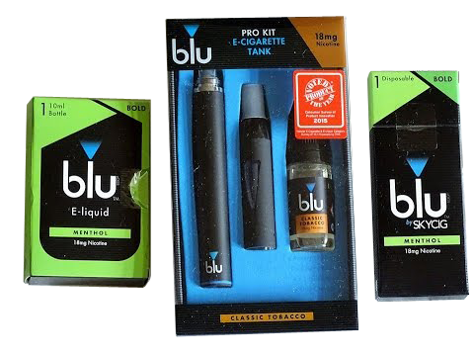


Tobacco giants like Philip Morris, Imperial Tobacco and British American Tobacco all own popular
(and well-advertised) e-cigarette brands, including
blu
Vype
Vuse
E-Lites
Notes:
E-cigarette companies claim that their products are different than regular cigarettes, yet often they are owned by the same parent companies.
Sources:
Campaign for Tobacco-Free Kids. (2013). 7 ways e-cigarette companies are copying big tobacco’s playbook. Retrieved from http://www.tobaccofreekids.org/tobacco_unfiltered/post/2013_10_02_ecigarettes
Ramamurthi, D., Fadadu, R. P., & Jackler, R. K. (2015). Electronic cigarette marketers manipulate antitobacco advertisements to promote vaping. Tobacco Control. doi:10.1136/tobaccocontrol-2015-052661

Slide 15
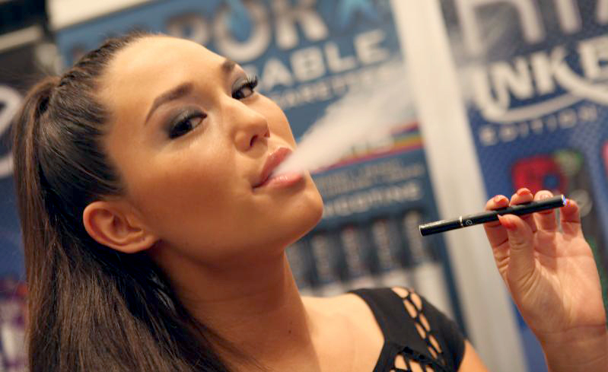
ESP advertisements use many of the same tactics
that cigarette companies have been using for years:
They have celebrity spokespeople.
Their ads feature manly men and glamorous women.
They know sex sells.
They sponsor sports and
music festivals.
Their products come in
sweet flavours.
They use cartoons.
Notes:
Ask the group “Do you think any of these tactics target youth? How?”

Slide 16
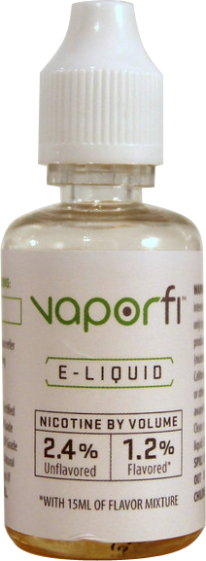

The liquid in e-cigarettes contains many cancer-causing substances, toxic chemicals and heavy metals, including
  formaldehyde
  arsenic
  lead
At their highest voltage settings, ESPs may produce higher levels of carcinogenic formaldehyde than what is found in tobacco smoke.
Because these products
are almost completely unregulated, there is
no guarantee that the information on their
labels is accurate.
Notes:
E-juice contains many of the same carcinogens as conventional tobacco (smaller amounts).
People vaping inhale many of the same chemicals contained in second-hand tobacco smoke.
These products can be made in huge industrial plants, in retail store-fronts (there are three in Red Deer alone), or in people’s garages or basements and then sold out of their vehicles or homes (one known in Sylvan Lake).
Sources:
Fernandez, E., Ballbe, M., Sureda, X., Fu, M., Salto, E., & Martinez-Sanchez, J. M. (2015). Particulate matter from electronic cigarettes and conventional cigarettes: A systematic review and observational study. Current Environmental Health Reports, 2(4), 423–429. Retrieved from http://link.springer.com/article/10.1007/s40572-015-0072-x
Goel, R., Durand, E., Trushin, N., Prokopczyk, B., Foulds, J., Elias, R. J., & Richie, Jr., J. P. (2015). Highly reactive free radicals in electronic cigarette aerosols. Chemical Research in Toxicology, 28(9), 1675–1677.
McCauley, L., Markin, C., & Hosmer, D. (2012). An unexpected consequence of electronic cigarette use. Chest, 141, 1110–1113.
Parliament of Canada. (2014). HESA (41-2). Minutes. Retrieved from http://www.parl.gc.ca/HousePublications/Publication.aspx?DocId=6733085&Language=E&Mode=1
Parliament of Canada. (n.d.). Vaping: Toward a regulatory framework for e-cigarettes. Retrieved from http://www.parl.gc.ca/HousePublications/Publication.aspx?DocId=7862816&File=18
Rogers, M. A., Greene, M. T., Saint, S., Chenoweth, C. E., Malani, P. N., Trivedi, I., & Aronoff, D. M. (2012). Higher rates of clostridium difficile infection among smokers. PLoS One, 7(7), e42091.
Russell, T. R. (2014). Elucidation of the cellular genes, pathways and biochemical mechanisms involved in HIV stimulation by aqueous tobacco smoke extract (Doctoral dissertation). Retrieved from ProQuest. (Publication No. 3624229)
Wu, W., Patel, K. B., Booth, J. L., Zhang, W., & Metcalf, J. P. (2011). Cigarette smoke extract suppresses the RIG-I-initiated innate immune response to influenza virus in the human lung. American Journal of Physiology—Lung Cellular and Molecular Physiology, 300(6), L821–L830.

Slide 17
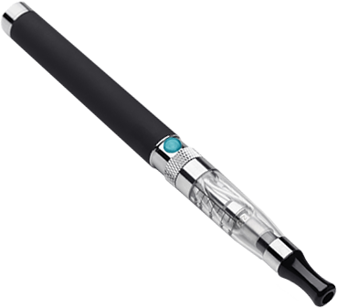
It is illegal in Canada to sell e-juice that contains nicotine.
However:
Many e-juice products sold in Canada
illegally contain nicotine.
Many e-cigarettes labelled as being
nicotine-free do, in fact, contain
nicotine (as many as 50% of
Canadian products, according
to Health Canada).
50%
of “nicotine-free” e-cigarettes contain nicotine.
Notes:
A study done by Health Canada found that over 50% of e-juice products that were labeled as nicotine-free actually contained nicotine.
They also found that the nicotine-containing products very often did not contain the amount of nicotine that was on the label.

Slide 18
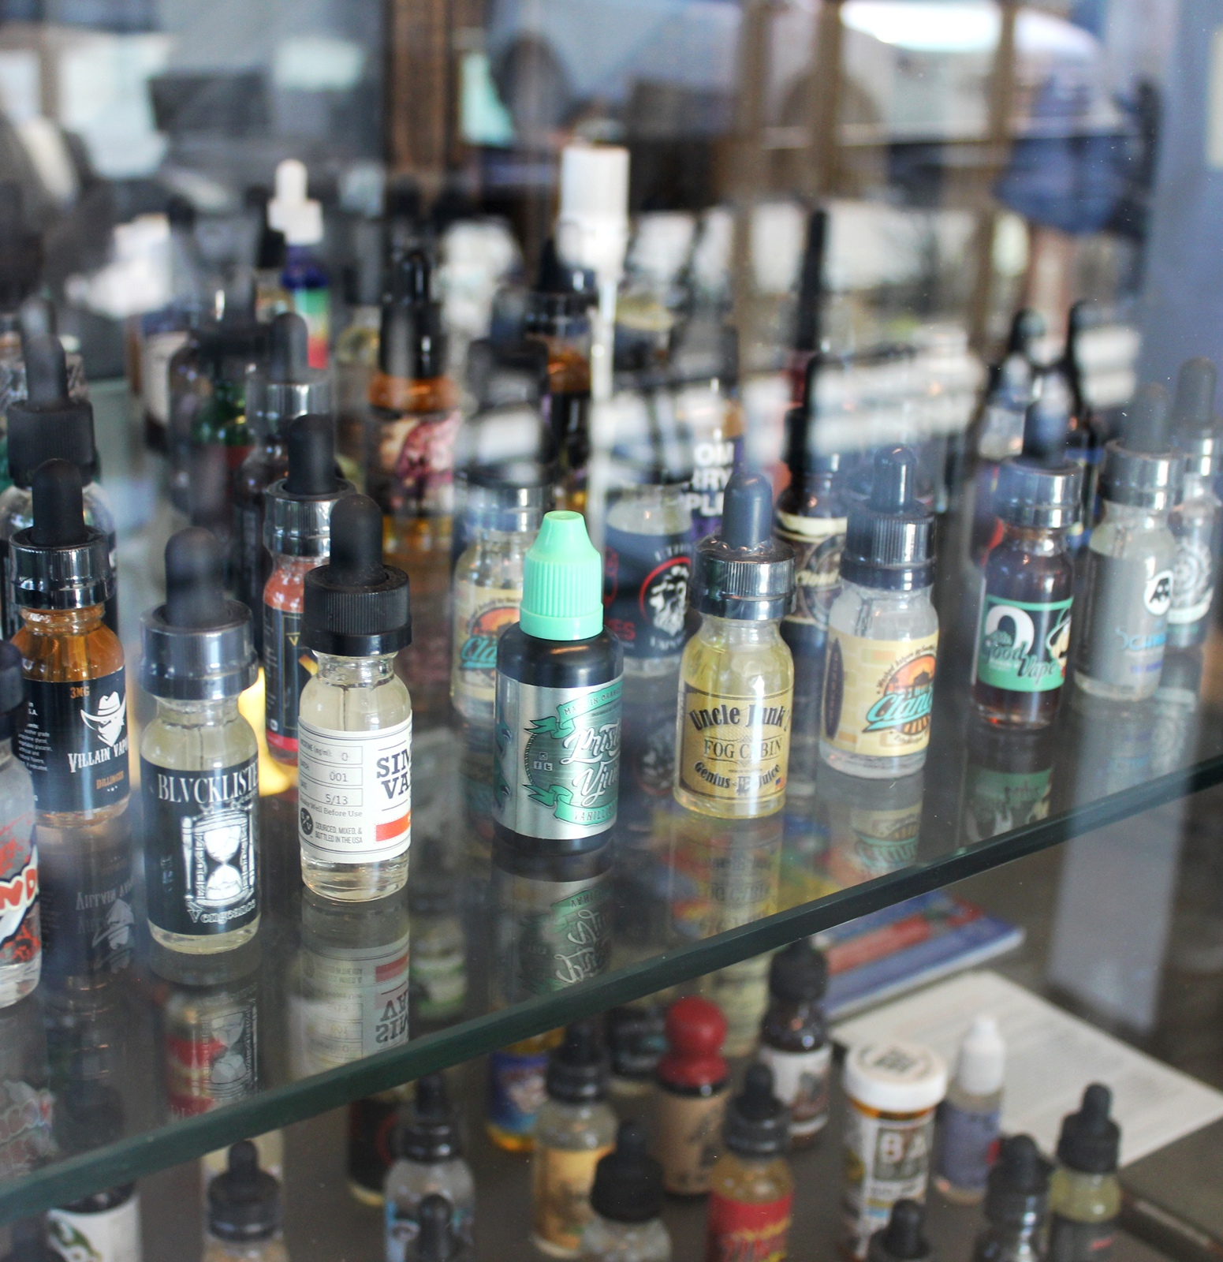
Today, there are nearly 8,000 e-cigarette flavours available.
Many buttery flavours come from diacetyl, 2,3-pentanedione and acetoin.
Cherry-flavoured electronic cigarettes expose users to benzaldehyde.
While these flavours make ESPs seem harmless and
more appealing to youth,
they may actually make the products more harmful.
Notes:
A 2014 study found that there are 7,700 flavours of e-cigarettes. Name a candy, a dessert or a cookie, and the flavour will be available somewhere.
Praised for their buttery taste, diacetyl, 2,3-pentanedione and acetoin are added to everything from chips and candy to cream cheese and ice cream.
They have been deemed safe to eat in trace amounts—but studies show they can be toxic when inhaled.
Benzaldehyde is also safe to eat, but has been shown to irritate a person’s airway when inhaled.
Many candy companies are suing the e-juice companies under copyright law for the misappropriation of trademarked names (e.g., Tootsie Roll, Creamsicle).
The chemicals needed to create these flavours may in fact make the products more harmful. The workers who manufacture these chemicals in plants have to wear protective gear because the fumes can be toxic.
These chemicals were originally intended for use in food products. They were never meant to be inhaled. The fact is we don’t know what the long or short-term effect of usage is for inhalation of most of these chemicals.
Sources:
Allen, J. G., Flanigan, S. S., LeBlanc, M., Vallarino, J., MacNaughton, P., Stewart, J. H., & Christiani, D. C. (2015). Flavoring chemicals in e-cigarettes: Diacetyl, 2,3-pentanedione, and acetoin in a sample of 51 products, including fruit-, candy-, and cocktail-flavored e-cigarettes. Environmental Health Perspectives. doi:10.1289/ehp.1510185
CDC Office on Smoking and Health. (2015). Electronic nicotine delivery systems: Key facts. Retrieved from http://www.cdc.gov/tobacco/stateandcommunity/pdfs/ends-key-facts2015.pdf
Davis, B., Razo, A., Nothnagel, E., Chen, M., & Talbot, P. (2015). Unexpected nicotine in do-it-yourself electronic cigarette flavourings. Tobacco Control. Research letter. Retrieved from http://tobaccocontrol.bmj.com/content/early/2015/07/26/tobaccocontrol-2015-052468.extract
Kosmider, L., Sobczak, A., Prokopowicz, A., Kurek, J., Zaciera, M., Knysak, J., Smith, D., Goniewicz, M. L. (2016). Cherry-flavoured electronic cigarettes expose users to the inhalation irritant, benzaldehyde. Thorax. doi: 10.1136/thoraxjnl-2015-207895
Netburn, D. (2014, June 17). The e-cigarette boom: Study finds 466 online brands, 7,700 flavors. Los Angeles Times. Retrieved from http://www.latimes.com/science/sciencenow/la-sci-sn-e-cigarette-7700-flavors-20140617-story.html
Zhu, S., Sun, J. Y., Bonnevie, E., Cummins, S. E., Gamst, A., Yin, L., & Lee, M. (2014). Four hundred and sixty brands of e-cigarettes and counting: Implications for product regulation. Tobacco Control, 23, iii3–iii9.

Slide 19
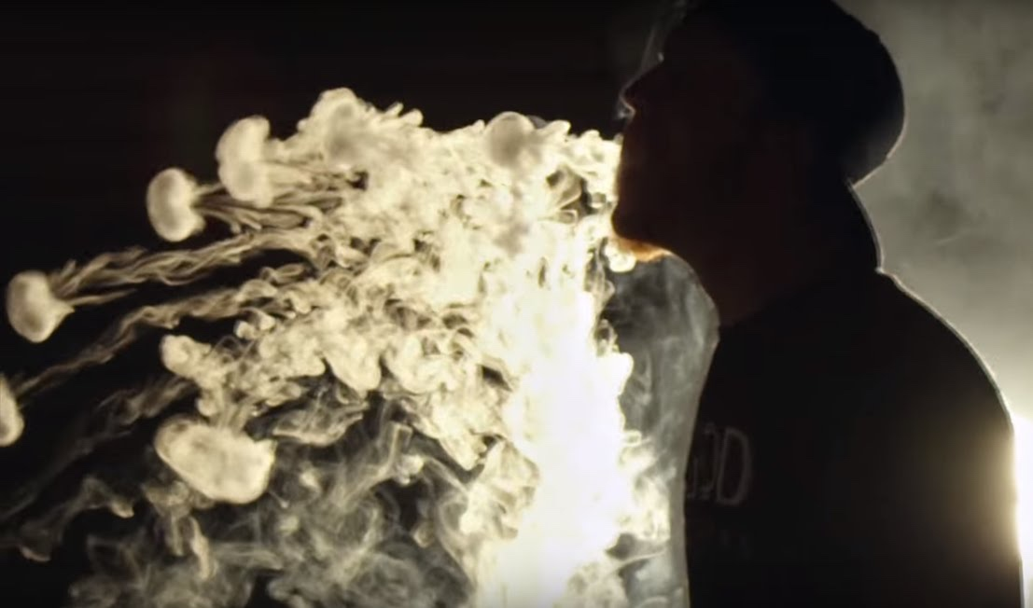
Notes:
Blowing smoke rings has become a counter-culture movement.
The internet is full of video tutorials on how to blow rings, and other tricks.
Like the use of flavours, youth using ESPs as toys makes them seem harmless and fun, when they are really not.
Sources:
Center for Environmental Health. (2015). A smoking gun: Cancer-causing chemicals in e-cigarettes. Retrieved from http://www.ceh.org/wp-content/uploads/CEH-2015-report_A-Smoking-Gun_-Cancer-Causing-Chemicals-in-E-Cigarettes.pdf
Parliament of Canada. (n.d.). Vaping: Toward a regulatory framework for e-cigarettes. Retrieved from http://www.parl.gc.ca/HousePublications/Publication.aspx?DocId=7862816&File=18
UCLA Newsroom. (2011). Tobacco smoking impacts teens’ brains, UCLA study shows. Retrieved from http://newsroom.ucla.edu/releases/teen-brains-impacted-by-smoking-192660
University of Michigan. (2015). Most youth use e-cigarettes for the novelty, flavors—not to quit smoking. Retrieved from http://www.monitoringthefuture.org//pressreleases/15ecigpr_complete.pdf

Slide 20

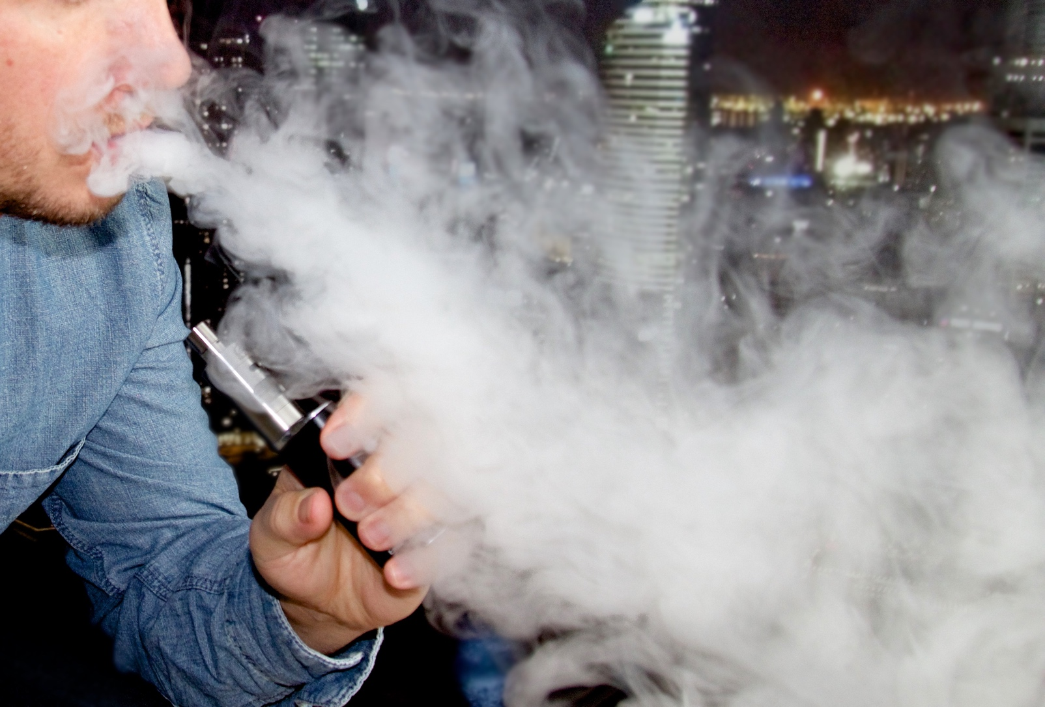
These are competitions where users produce large clouds
of vapour (also called extreme vaping or sub ohm vaping).
Dangers of sub ohming:
  The ESP’s battery can be
  damaged very quickly.
  A chain reaction
  known as thermal
  runaway can occur.
  These factors increase
  the risk of fire or
  explosion.
Notes:
What is sub ohm vaping?
Basically, the idea is to try to produce as much vapor as possible (by trying to reproduce, as close as possible, the effect of dripping but without the inconvenience, using a coil setup that produces next to no resistance and that is less than 1 ohm).
Thermal runaway: A chemical reaction that produces heat, which triggers another chemical reaction, which produces more heat—and so on.

Slide 21
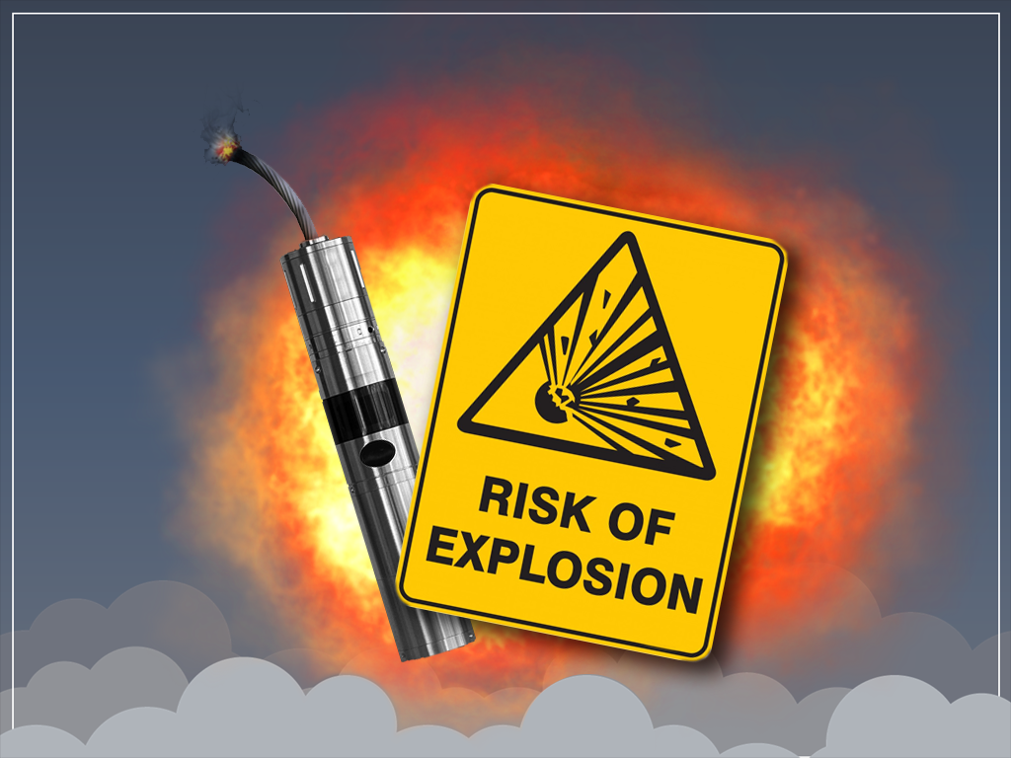
Notes:
ESPs are at risk of catching on fire, and their battery chargers are known to explode, especially the cigarette-like ESPs or those that have been modified.
There are many reports of users around the world being severely burned from their ESP. Some have even died as a result of their injuries.
In January, a teenager in Lethbridge was smoking an e-cigarette when it exploded in his mouth, leaving first- and second-degree burns on his face.
The U.S. and Canadian departments of transportation have ruled that e-cigarettes pose a fire risk, and therefore cannot be packed in checked luggage. (They must be carried inside the aircraft cabin instead.)
There have been several incidents of e-cigarettes overheating or catching fire when the heating element was accidentally activated.
These products should not be left unattended when charging anywhere, especially in a vehicle.
Sources:
Abram, S. (2015, November 19.) 3 men severely burned when e-cigarette batteries explode file lawsuit. Los Angeles Daily News. Retrieved from http://www.dailynews.com/general-news/20151119/3-men-severely-burned-when-e-cigarette-batteries-explode-file-lawsuit
Fausto, A. (2016, March 23.) Orange Coast College student gets 2nd-degree burns after e-cigarette batteries ignite in pocket. Orange County Register. Retrieved from http://www.ocregister.com/articles/batteries-709292-coates-fire.html
Ismail, A. (2014, October 6.) E-cigarette explodes, killing smoker. Borneo Post. Retrieved from http://www.theborneopost.com/2014/10/06/e-cigarette-explodes-killing-smoker/
Nsubuga, J. (2014, April 8.) E-cigarette explodes in barmaid’s face after being put on iPad charger. Metro UK. Retrieved from http://metro.co.uk/2014/04/08/video-e-cigarette-explodes-in-barmaids-face-after-being-put-on-ipad-charger-4692238/
Rudy, S. F., & Durmowicz, E. L. (2016). Electronic nicotine delivery systems: overheating, fires and explosions. Tobacco Control. doi:10.1136/tobaccocontrol-2015-052626
Tams, K. (2016, January 26.) Alberta teen injured after he says e-cigarette exploded. Global News Edmonton. Retrieved from http://globalnews.ca/news/2479197/alberta-teen-injured-after-he-says-e-cigarette-exploded/
Transport Canada. (2015). Fire risk of electronic cigarettes in checked baggage on board an aircraft. Retrieved from https://www.tc.gc.ca/eng/tdg/publications-alerts-menu-1223.html
U.S. Department of Transportation. (2015). DOT issues new flight safety rule for e-cigarettes. Retrieved from https://www.transportation.gov/briefing-room/dot-issues-new-flight-safety-rule-e-cigarettes

Slide 22


Liquid nicotine can be absorbed through the skin, inhaled or ingested—all of which could lead to nicotine poisoning.
It can be lethal if ingested:
  60 mg for adults
  6 mg for children
Even one concentrated teaspoon of nicotine can
kill a small child.
Notes:
The liquid nicotine in e-cigarettes is usually nicotine sulfate—a powerful neurotoxin.
This can poison a child or a pet if they inhale the vapour, swallow the liquid, or spill the liquid onto their skin.
If this happens, call poison control immediately.
Liquid nicotine should be stored and disposed of as a poison.
E-cigarettes account for more and more cigarette-related exposure calls to U.S. poison control centres—from 0.3% in September 2010 to 41.7% in February 2014.
From September 2010 to February 2014, U.S. poison centers reported 2,405 e-cigarette exposure calls and 16,248 cigarette exposure calls.
Among the 9,839 exposure calls that gave information about the severity of adverse health effects, e-cigarette exposure calls were more likely to report an adverse health effect after exposure than cigarette exposure calls (57.8% versus 36.0%).
Source:
Centers for Disease Control and Prevention. (2014). Notes from the field: Calls to poison centers for exposures to electronic cigarettes—United States, September 2010–February 2014. Morbidity and Mortality Weekly Report, 63(13), 292–293. Retrieved from http://www.cdc.gov/mmwr/preview/mmwrhtml/mm6313a4.htm

Slide 23


Youth may experiment with
e-cigarettes because they have
heard they are fun, harmless or
a way to quit using tobacco.
Using e-cigarettes may convince youth who would otherwise never try tobacco to use a tobacco product.
Some studies have found that
people who use ESPs that contain nicotine are likely to later also use tobacco products.
Many youth who don’t smoke associate e-cigarettes with a willingness to use tobacco later.
Notes:
Some studies have found that adolescents who use e-cigarettes are more likely to start smoking cigarettes.
Policies restricting youth access to e-cigarettes make sense from a public-health standpoint.
E-cigarettes should not be sold to youth, and perhaps also not to tobacco users who think they will reduce harm or help them quit tobacco.
Sources:
NYU Langone Medical Center. (2015). Use of e-cigarettes and alternative tobacco products may lead to increased tobacco use. Retrieved from http://www.eurekalert.org/pub_releases/2015-10/nlmc-uoe101315.php
Primack, B. A., Soneji, S., Stoolmiller, M., Fine, M. J., & Sargent, J. D. (2015). Progression to traditional cigarette smoking after electronic cigarette use among U.S. adolescents and young adults. JAMA Pediatrics, 169(11), 1018–1023. doi:10.1001/jamapediatrics.2015.1742
University of Michigan. (2015). Most youth use e-cigarettes for the novelty, flavors—not to quit smoking. Retrieved from http://www.monitoringthefuture.org//pressreleases/15ecigpr_complete.pdf
Wills, T. A., Knight, R., Sargent, J. D., Gibbons, F. X., Pagano, I., & Williams, R. J. (2016). Longitudinal study of e-cigarette use and onset of cigarette smoking among high school students in Hawaii. Tobacco Control. doi:10.1136/tobaccocontrol-2015-052705
Wills, T. A., Knight, R., Williams, R. J., Pagano, I., & Sargent, J. D. (2015). Risk factors for exclusive e-cigarette use and dual e-cigarette use and tobacco use in adolescents. Pediatrics, 135(1), e43–e51.
Wills, T. A., Sargent, J. D., Knight, R., Pagano, I., & Gibbons, F. X. (2015). E-cigarette use and willingness to smoke: A sample of adolescent non-smokers. Tobacco Control. doi:10.1136/tobaccocontrol-2015-052349

Slide 24


ESPs should not be used by pregnant women.
There are at least ten chemicals commonly found in ESPs that are linked to cancer and birth defects.
Notes:
More research is needed to understand the impact of fetuses being exposed to e-cigarettes over time.
Sources:
American Pregnancy Association. (2015). Electronic cigarettes and pregnancy. Retrieved from http://americanpregnancy.org/is-it-safe/electronic-cigarettes-and-pregnancy/
Center for Environmental Health. (2015). A smoking gun: Cancer-causing chemicals in e-cigarettes. Retrieved from http://www.ceh.org/wp-content/uploads/CEH-2015-report_A-Smoking-Gun_-Cancer-Causing-Chemicals-in-E-Cigarettes.pdf
Chapman, Ron, MD, MPH (2015). State Health Officer’s Report on E-Cigarettes: A Community Health Threat. California Department of Public Health. January 2015.
Etter, J. F., Bullen, C., Flouris, A. D., Laugesen, M., & Eissenberg, T. (2011). Electronic nicotine delivery systems: A research agenda. Tobacco Control, 20(3), 243–248. Retrieved from http://www.ncbi.nlm.nih.gov/pubmed/21415064

Slide 25
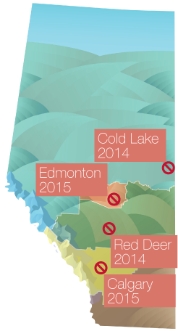
Alberta Cities with
E-cigarette Regulations
The World Health Organization (WHO) recommends regulating ESPs the same way we do for tobacco, including restricting where and how they can be used.
Several Alberta cities (Edmonton, Calgary, Red Deer, Cold Lake) have included
e-cigarettes in their tobacco laws.
Currently there are no national
standards or regulations for
  health claims
  safety
  labelling
  checking the ingredients
  advertising or selling to minors
Notes:
For instance, the bylaw in Red Deer bans the use of ESPs in all indoor and outdoor areas where smoking is also banned.
It also bans ESP use on public patios, café sidewalks, and certain areas where children may be present, including
playgrounds
skate parts
sports fields
parade routes
festivals
water/spray parks
The lack of regulation in other places allows vape shops to host public cloud-chasing events, which appeal to youth.
Source:
World Health Organization. (2014). Backgrounder on WHO report on regulation of e-cigarettes and similar products. Retrieved from http://www.who.int/nmh/events/2014/backgrounder-e-cigarettes/en/

Slide 26


The health effects of e-cigarettes
and ESPs are still being studied.
However, there is no conclusive evidence that using e-cigarettes helps people quit smoking long-term.
Because of the lack of evidence and possible health risks, Health Canada advises not to use e-cigarettes.
Many communities and organizations are creating laws and policies that ban the use of ESPs.
Notes:
Sources:
MyHealth.Alberta.ca. (2015). Electronic cigarettes (e-cigarettes). Retrieved from https://myhealth.alberta.ca/Alberta/Pages/Electronic-cigarettes.aspx

Slide 27

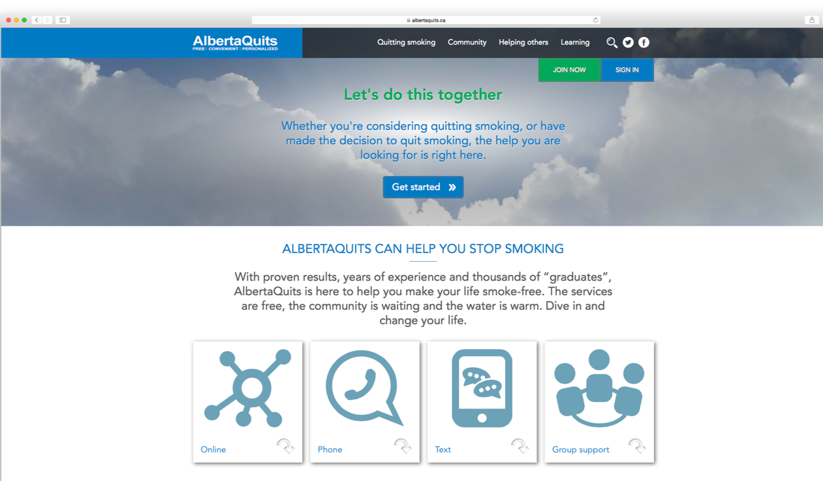
For additional information and support, visit
Notes:
Your local public health office can provide more information on e-cigarettes and other ESPs. Contact them if you have any questions.

