Slide 1
Cannabis

Slide 2
Cannabis
3 forms
Marijuana: greenish or brownish mixture of the dried, shredded leaves and flowers of the cannabis sativa plant
Hashish: cannabis resin that is secreted from the plant; texture varies from hard and dry to soft and gummy
Hash oil: thick, dark, oil made by separating resins from cannabis buds with a solvent. It can be further processed to produce “shatter”.
Notes:
There is also synthetic marijuana, but it is not derived from the cannabis sativa plant…it is man-made.
K2, Spice, Happy Shaman, Spirit 4:20
Man made herbal [drug] that produce powerful marijuana-like effects; however, the drug does not contain any real marijuana.
It is a mix of herbs sprayed with man-made chemicals that mimic the effects of marijuana.
Drug is typically smoked or swallowed.
Different types of this drug exist and the exact ingredients vary and are not indicated on the product wrapping.
source Health Canada
What is Shatter?
a weed concentrate that packs up to 80 percent cannabinoid content.
Shatter is just one form of dabs, the catch-all term for marijuana concentrates produced by extracting cannabinoids like THC and CBD, the plant’s psychoactive chemicals. Other well-known forms include “budder,” which has a creamier, wax-like consistency, and oils, which are golden and honey-like. For all dabs, extraction involves running a solvent — usually butane, carbon dioxide, or propane — through marijuana buds to pull out the cannabinoids, then evaporating the solvent and gathering the resins left behind.

Slide 3
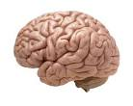
How it works
THC quickly passes from the lungs (if smoked) to the bloodstream then reaches the brain
Acts upon cannabinoid receptors in the brain
Highest density of these receptors are located in areas that influence pleasure, memory, thinking, concentrating, sensory/time perception and coordination

Slide 4
Why youth use cannabis (the benefits)
6 Categories of Motivation to use:
Enhancement – “it’s exciting”
Social – “it helps me enjoy a party”
Coping – “it helps me forget about my problems”
Expansion – “it helps me understand things differently”, “I can be more creative”
Conformity – “so I won’t feel left out”
Routine – “I use it out of boredom”

Slide 5
Other Benefits
Medicinal marijuana
Has been prescribed for people with MS (muscle spasms), seizure disorders, HIV (nerve pain, stimulate appetite), cancer (nausea), chronic pain (fibromyalgia, arthritis, etc), Crohn’s disease
Notes:
In Canada, cannabis for medical purposes is legally accessed through the Marihuana for Medical Purposes Regulations (MMPRs) (Government of Canada, 2013). Because the cannabis accessed through this program
is monitored and standardized, it is less risky to use than cannabis that is obtained illegally, which may be contaminated with unknown substances. In addition, there are currently four other cannabinoid products available for medical use in Canada—more than in any other country worldwide. The forms of cannabinoids that are used or tested as medicines by physicians aremainly the following:
• Dronabinol: Synthetic THC in pill form that is marketed as Marinol®;
• Nabilone: A synthetic derivative of THC in pill form that is marketed as Cesamet®;
• Cannabidiol: Although not used medically by itself, it is a constituent of an oral spray containing equal proportions of THC and cannabidiol that is marketed as SativexR; and
• Plant-derived THC: The primary psychoactive cannabinoid component of the cannabis plant that produces the high.
There are only a few approved therapeutic uses for these aforementioned cannabinoid products. In many countries, including Canada, they are approved to relieve and prevent nausea and vomiting caused by anticancer chemotherapy, and to stimulate appetite in AIDS patients with a severe loss of body weight. In Canada, SativexR is also approved for the relief of pain due to disease of the nervous system, of pain and spasticity (muscular stiffness) due to multiple sclerosis, and of severe pain due to advanced cancer. SativexR is undergoing clinical trials in the United States and is available on a limited basis by prescription in the United Kingdom and Spain. In addition to these cannabinoid products, levonantrodol, which can be given by injection or orally, is a very potent cannabinoid that exhibits antinausea and pain-relieving effects. Although levonantrodol is available in some countries, it is not currently approved in Canada, the United States or Western Europe.
Under the MMPRs (Marihuana for Medical Purposes Regulations), Health Canada no longer issues authorizations. Individuals must receive a medical document (e.g., a prescription) from a medical practitioner to authorize use. All medical marijuana must be obtained from a producer licensed by Health Canada, from a healthcare practitioner or from a hospital. Individuals cannot grow their own.
(Clearing the Smoke on Cannabis: Medical Use of Cannabis and Cannabinoids)

Slide 6
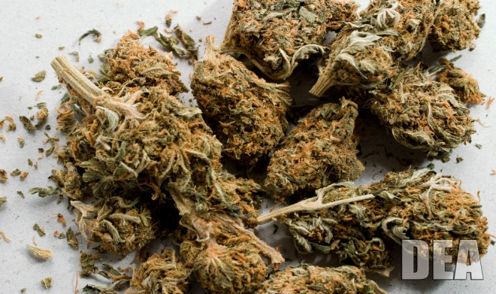
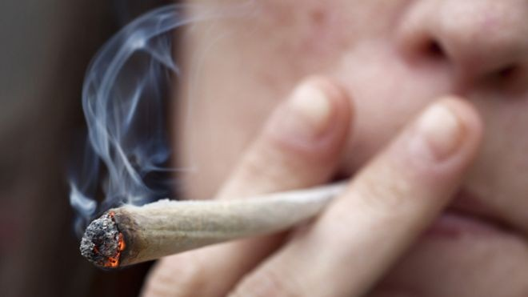
Impact on youth
Effects of cannabis on youth depends on:
Dose (how much of the drug you take)
Potency (how ‘strong’ the drug is)
Cumulative exposure (how long you have been using and when you started using the drug)
Notes:
Dose – the amount of active ingredient to which youth are exposed during each episode of use varies according to the overall substance content (i.e. proportions of cannabis and non-cannabis ingredients), the mode of administration (e.g. joints, vaporizers), and individual versus shared use
Potency – much higher now than it was in the 60’s and 70’s, due to new cultivation and growing practices
Exposure – the earlier you start to use cannabis, the more impact it has on the developing brain, health, etc.
Because cannabis is currently illegal, there are no regulations on content and potency, so the cannabis that someone may smoke may contain a variety of different drugs/chemicals and “filler” rather than pure cannabis.

Slide 7
Acute Effects
Inexperienced users may experience
Intense anxiety
Panic
Psychotic symptoms
Risk of overdose is very low (even among individuals with the highest levels of use)
Driving while under the influence of cannabis
Notes:
Driving – 10-20% of senior students (licensed drivers) reported driving within one hour of using cannabis which is nearly identical to the rates reported for driving under the influence of alcohol.
Although evidence suggest it is not quite as dangerous as driving under the influence of alcohol, driving under the influence of cannabis is still associated with a significantly increased risk of collision and injury; that risk climbs even higher when driving under the influence of both alcohol AND cannabis.

Slide 8
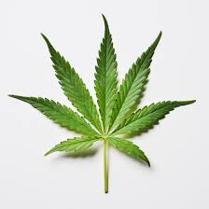
Short term effects
Euphoria and relaxation
Changes in perception, time distortion and deficits in attention span and memory
Body tremors and impaired motor functioning, including impaired coordination and balance
Increased heart rate and appetite
Increased blood pressure, dilated pupils, red eyes, dry mouth and throat, and bronchodilation

Slide 9
Long term effects
Chronic cannabis use is associated with:
Deficits in memory, attention, psychomotor speed and executive functioning, particularly among those who started using cannabis during early adolescence.
Increased risk of breathing problems and respiratory conditions, and possibly lung cancer
Notes:
Brain and behavioral effects of cannabis use in youth?
A number of key neurodevelopment phases must occur during adolescence before the brain is fully ready for adulthood. The brains’ process of pruning inefficient neurons and insulating axons optimizes it for future success, but also makes youth more vulnerable to the effects of cannabis use. The regions of the brain that undergo the most fine-tuning during the teenage years are those responsible for decision making, judgment, planning and problem solving, and these regions are potentially most susceptible to cannabis when they are not yet fully developed.
The Endocannabinoid system (the internal cannabinoid receptors in the brain) can be high jacked by the psychoactive component of cannabis, delta-9-tetrahydrocannabinol (THC). THC induces neurotoxic changes that affect the natural process of neurodevelopment in adolescence and in turn promote physical changes in the brain’s structure – effectively altering the functions responsible for emotional and cognitive performance.
The human brain makes its own chemicals that resemble the psychoactive component of cannabis, delta-9-tetrahydrocannabinol (THC). Two of these naturally occurring cannabinoids, anandamide and 2-arachidonoyl-glycerol (2-AG), are considered neurotransmitters because they bind to cannabinoid receptors (CB1 and CB2) located in the prefrontal cortex, anterior cingulate, basal ganglia, amygdala, hippocampus and cerebellum (Herkenham, Lynn, Melvin, de Costa, & Rice, 1991; Batalla et al., 2013).
This endocannabinoid system plays an important role in the maturation of the cortical neuronal networks that reach maximal levels during late adolescence. It is also involved in modulating other neurotransmitter systems such as dopamine, enhancing brain cell growth and, ultimately, controlling brain functions such as appetite, motor activity, motivation, mood, immune system activity, reward, learning and memory (Breivogel & Sim-Selley, 2009; Gray, 2013; Pope, Mechoulam, & Parson, 2010).
The presence of endogenous cannabinoids (i.e., those occurring in the brain) has led some to suggest that cannabis use is “natural” and benign. However, when THC is taken into the brain, it targets the CB1 receptors in much higher quantities than endogenous cannabinoids, effectively flooding the system to the point that it no longer works efficiently. This “hijacking” of the endocannabinoid system wreaks havoc on many complex neurophysiological processes, disrupting the regulatory role the system plays and inducing neurotoxic changes in brain regions rich with CB1 receptors (Breivogel & Sim-Selley, 2009). These neurotoxic changes have been shown to dramatically affect the natural process of neurodevelopment in adolescence and, in turn, promote physical changes in the brain’s structure — effectively altering the functions responsible for emotional and cognitive performance (Batalla et al., 2013).
Given that CB1 receptors are widely dispersed throughout the brain, many different types of behaviour are affected by cannabis use, ranging from academic performance to motivation to psychomotor skills like driving. While there are many individual-level variables that make it difficult to make unequivocal assertions, through the use of both neuropsychological testing and neuroimaging technologies, the evidence is mounting that early onset cannabis use has a tremendous impact on the structure and functioning of the teenage brain and can weaken the foundation for future life success.

Slide 10
More long term effects
Fastest rate of transition to substance use disorder (compared to alcohol or tobacco)
Heavy cannabis use is associated with an increased risk for dependence
Regular use associated with psychotic symptoms (especially when there is a family or personal history of psychotic disorders)
Notes:
When compared to alcohol and tobacco, cannabis use has the fastest rate of transition to substance use disorder among adolescents. Youth who are regular cannabis users are more likely to use other illicit substances.
The risk of dependence is approximately 9% among individuals with any lifetime cannabis use and approximately 16% among those who initiated cannabis use during adolescence. While most individuals who use cannabis do not become dependent, heavy cannabis use in adolescence is associated with an increased risk for dependence. Symptoms of tolerance and withdrawal (such as depression, insomnia, anxiety, disturbances in appetite) are reported by some cannabis users, experience typically in the context of high-frequency, long-term use.
The risk of reporting psychotic symptoms or being diagnosed with schizophrenia in adult hood is doubled in individuals with regular cannabis use in adolescence. While the evidence is not as strong regarding other mental health issues, there are possible links between regular cannabis use in youth and increased risk for depression and suicide.

Slide 11
What Canadian Youth Think About Cannabis Use
Influences for smoking and not smoking cannabis
Perceived positive and negative effects
Cannabis as natural and safe…not a drug
Cannabis and driving
Legality of cannabis
Perceptions of effective prevention approaches
Notes:
Influences for Smoking and Not Smoking Cannabis
Parents, siblings and friends appear to influence decisions by young people to use cannabis. Youth in the study mentioned that some parents do not make their position on cannabis use clear. Other parents, it was felt, use cannabis with their kids or are disengaged from their children’s lives. Peer pressure, social connectedness to peers and the drug’s perceived popularity and availability were also mentioned as factors influencing use. In fact, youth held a common belief that “everyone smokes weed” and perceived that not using cannabis is abnormal:
Concerns about health risks, poor academic performance and the negative impacts on family relationships were also felt to prevent youth from using cannabis. Interestingly, trouble with the law was not mentioned as a factor deterring use.
Perceived Positive and Negative Effects of Cannabis
Youth in the study discussed perceived positive effects more often than negative effects. These included the drug’s ability to help youth focus, relax, sleep, be less violent and improve creativity, as well as how it can purify your system or cure cancer:
Perceived negative effects included developing dependency, losing focus, becoming lazy, developing lung and heart conditions, and increasing criminality. Participants perceived cannabis to affect each person differently, and negative effects, including long-term changes in chronic users, were attributed to the individual and not cannabis itself.
Cannabis as Natural and Safe, and Not a Drug
Many youth did not consider cannabis to be a drug. When asked why, responses included that it was natural (not man-made), safe and non-addictive, and that it reduced violent tendencies and did not change the user’s perception of reality, unlike harder drugs.
It was widely felt cannabis is much safer than alcohol and tobacco. Participants preferred the term “smoking weed” to “using cannabis,” given that the term “using” was associated with addiction to harder drugs.
Cannabis and Driving
A number of the youth believed that cannabis is safe and makes people better drivers by increasing their focus. Drunk driving was seen as being much more dangerous than driving under the influence of cannabis. In contrast, others felt that using cannabis while driving is dangerous and constitutes impaired driving. However, even those opposed to using cannabis and driving stated that it is not as dangerous as drunk driving.
Legality of Cannabis
Participants were confused about the legality of cannabis. Some felt cannabis was legal depending on age and the amount in your possession. It appeared that the inconsistent reactions of police to cannabis and the legality of medical marijuana were, in part, leading to the confusion.
Perceptions of Effective Prevention Approaches
In the study youth argued that general information about drugs presented using scare tactics is an ineffective approach to prevention. They suggested that effective approaches would involve providing more fact-based information at an earlier age, providing more content relating specifically to cannabis (and not all drugs) and using approaches that are aimed at reducing the harms of using cannabis, rather than focusing on abstinence.
Participants also suggested that to be effective prevention efforts should ensure that those who deliver prevention messages have an ability to connect with youth. They need to be someone they trust.

Slide 12
Legalization and Regulation
The Framework for the Legalization and Regulation of Cannabis in Canada suggests:
Minimizing Harms of Use
Establishing a Safe and Responsible Supply Chain
Enforcing Public Safety and Protection
Medical Access
Implementation

