Slide 2
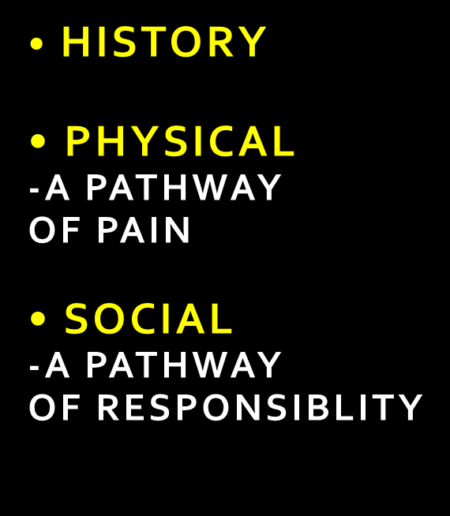
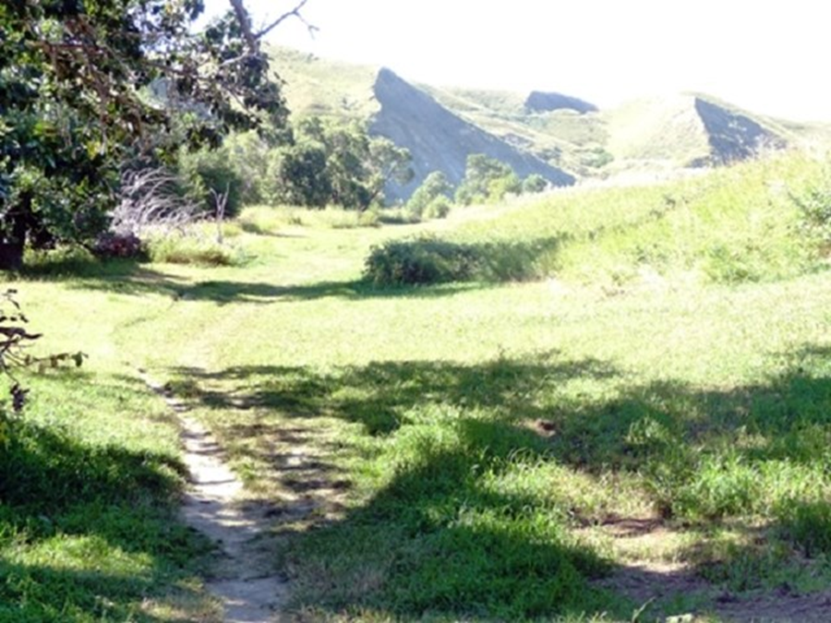

Slide 3
History of Alcohol Use
The Bible gives many indications that wine can be used in a way that carries a blessing with it.
In many places wine is included as one of many promised blessings that God would give if His covenant was kept. (Deuteronomy 7:13; 11:14; 33:28)
If Israel disobeyed, they would work in their vineyards but not taste of the wine from them. (Deut. 28:39,51, Hosea 9:2; Joel 1:10; Amos 5:11; Micah 6:15; Zephaniah 1:13; Haggai 1:11)
God cursed Israel’s enemies on several occasions by emptying their winepresses. (Isaiah 16:10; Jeremiah 48:33)

Slide 4
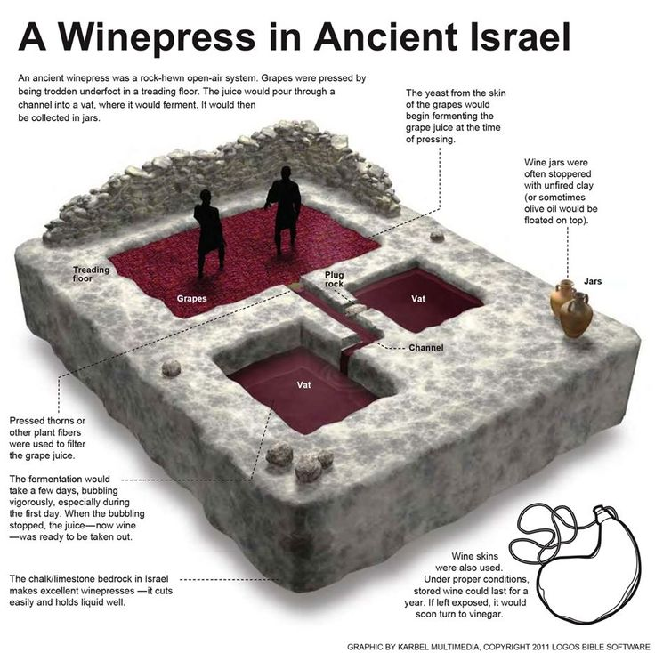

Slide 5
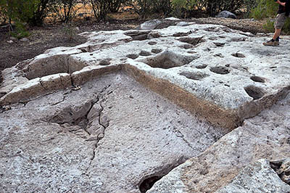
A winepress in a vineyard in Jezreel. Very likely the location of Naboth’s vineyard. God promised to punish Ahab but delayed when Ahab ‘repented’. The punishment passed to his son Joram who was shot in the back by an arrow from the bow of Jehu and his body was thrown in the vineyard of Naboth!

Slide 6
History of Alcohol Use
The Bible gives many indications that wine can be used in a way that carries a blessing with it.
4. God allowed the Levites to receive wine as part of the payments or tithes they were given. (Num. 18:30)
5. Those travelling to the festival of giving of the first fruits were encouraged to buy food or wine to help them commemorate the festival when they arrived in Israel.
“And if the way be too long for thee, so that thou art not able to carry it; or if the place be too far from thee, which the Lord thy God shall choose to set his name there, when the Lord thy God hath blessed thee: Then shalt thou turn it into money, and bind up the money in thine hand, and shalt go unto the place which the Lord thy God shall choose: And thou shalt bestow that money for whatsoever thy soul lusteth after, for oxen, or for sheep, or for wine, or for strong drink, or for whatsoever thy soul desireth: and thou shalt eat there before the Lord thy God, and thou shalt rejoice, thou, and thine household. (Deut. 14:24-26)
Wine was poured out over sacrifices.
(Exodus 29:40; Leviticus 23:13; Num. 15:5,7,10 18:12; 28:7,14; Deut. 18:4; 1 Samuel 1:24; 2 Chronicles 31:5; Ezra 6:9; 7:22; Nehemiah 5:11; 10:37,39; 13:12)

Slide 7
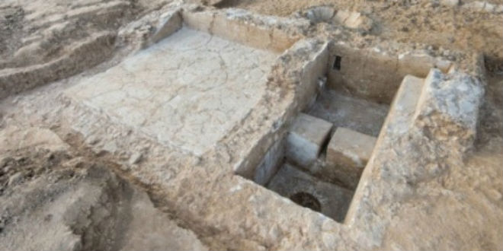
Another very well built winepress in Ashkelon, untouched from 600 B.C. when Nebuchadnezzar conquered the Philistines and carried them away into captivity.
In the time of the Romans, production of wine was one of the major ways to bring money in to support the Roman armies.

Slide 8
History of Alcohol Use
The Bible gives many indications that wine can be used in a way that carries a blessing with it.
7. Wine was appropriate for Feasts, Weddings and Celebrations. “He brought me to the banqueting house” (house of wine literally) (Song of Solomon 2:4).
8. God chose wine over many other possible comparisons to demonstrate the riches of his shed blood. The cup of wine at the Last Supper was called the ‘Cup of Blessing’ by Paul. (Matt 26:28)
9. Christ speaks with longing for the time when he will ‘drink it (wine) new’ with his redeemed ones in ‘My Father’s Kingdom’. (Matt 26:29)

Slide 9
History of Alcohol Use
The Bible gives MANY MORE indications that drinks containing alcohol can be abused and bring much suffering with it.
The first mention of fermented drink in Genesis was the sad story of Noah’s drunkenness. (Genesis 9:21) Lot fell soon after.
The Israelites were fed by the Lord in the wilderness for 40 years and never once a drop of wine or strong drink. (Deut 29:5,6)
The Bible never separates a ‘safe’ type of wine from unsafe wine. It does use the word SHEKAR for ‘strong wine’ or ‘strong drink’. The word for drunkenness is SHAKAR.
Paul warns against being ‘given to wine’ (addicted) or ‘enslaved’ to wine especially those in high office. (I Tim. 3:8, Titus 2:3)
5. There are over 75 references to drunkenness in the Bible.

Slide 10
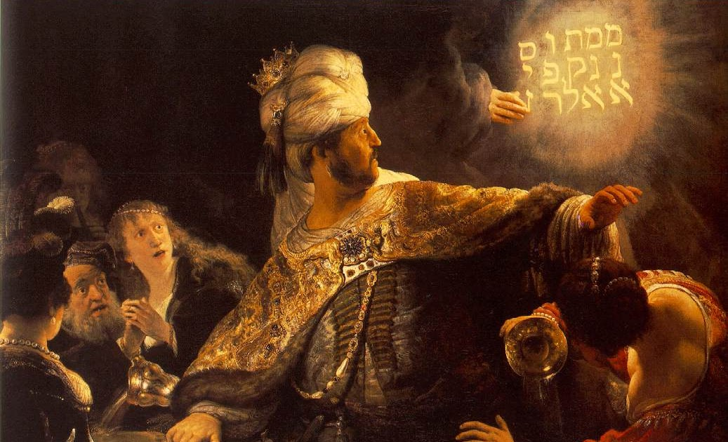
King Belshazzar (553 BC) “…whiles he tasted the wine, commanded to bring the golden and silver vessels”
Rembrandt Painting of Belshazzar’s Feast (1635)

Slide 11
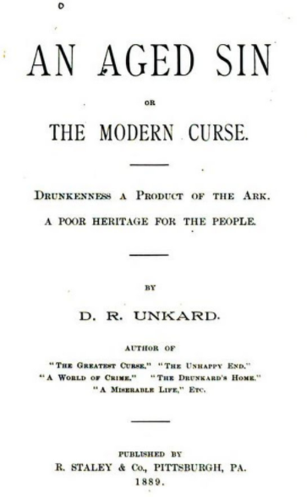
“Noah survived one flood, only to be the source of another; a flood that for its disastrous results and heartrending consequences has outrivaled the flood of his preserver.
For the sparkling, crimson fluid from Noah's wine press has been the cause of misery for millions of helpless, struggling, pitiful human objects, carrying them on and on to an ocean of woe—to a deep, dark sea of oblivion.
Today the world is drenched from the accursed stream. In every land the juice of his press is drank.”
--DR. UNKARD - 1889

Slide 12
Drinking Alcohol - Down a Pathway of Pain
Swallowed through the mouth.
--Daily drinking doubles your risk of head and neck cancers
2. A small amount is absorbed through the stomach wall, most is absorbed by intestines

Slide 13
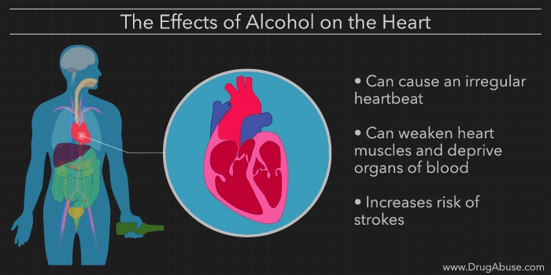
Drinking Alcohol - Down a Pathway of Pain
3. The blood carries the alcohol and its effects to the rest of the body. Frequent drinking makes the blood gets ‘thicker’ and clots form.
4. The heart beats faster and out of rhythm. Blood vessels open up bringing blood closer to skin. This allows heat to escape more quickly

Slide 14
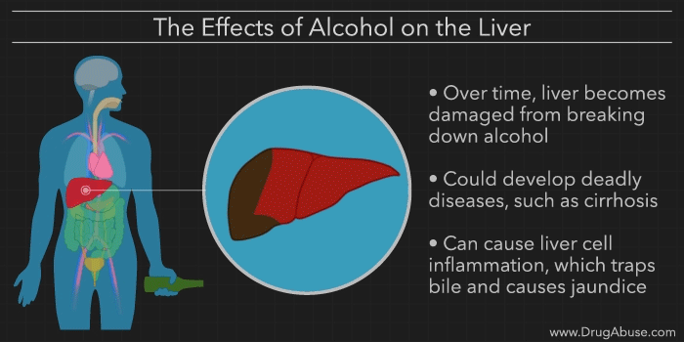
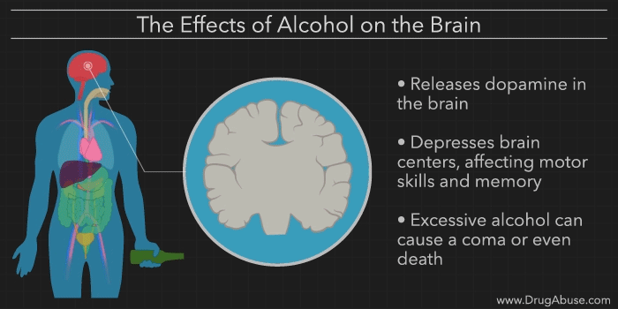
Drinking Alcohol - Down a Pathway of Pain
5. The liver is where the alcohol is detoxified. This means the liver turns it into water, carbon dioxide, and energy. The speed at which it does this is 15 mL per hour in a typical adult.
6. The brain is slowed down or ‘depressed’ by the alcohol. This affects vision, hearing, speech, fine motor skills, and concentration.

Slide 15
Drinking Alcohol - Down a Pathway of Pain
7. The pancreas becomes inflamed. This leads to scarring and chronic loss of insulin and digesting enzymes.
8. Alcohol promotes more urine flow. The bladder lining gets inflamed and swollen. This can cause blockage of urine flow and kidney failure.

Slide 16
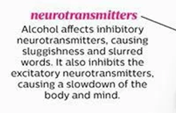
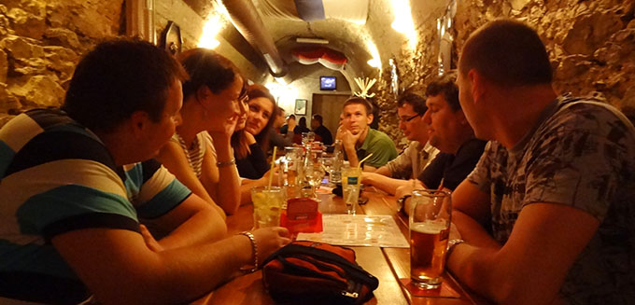
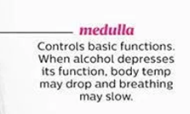
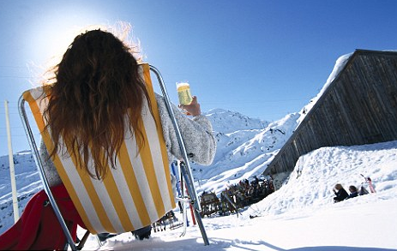
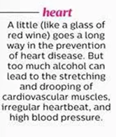
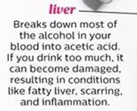
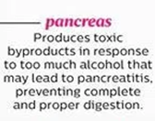
The effects of alcohol begin gradually…

Slide 17
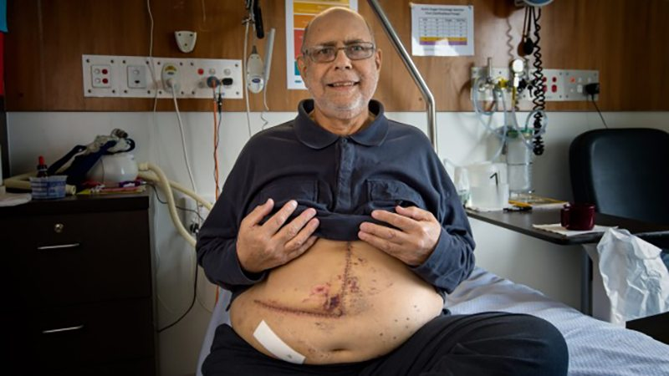
Drinking Alcohol - Down a Pathway of Pain
Meet John, 68 years old, my patient of 15 years. His body has become a personal teaching tool for the horrible effects of alcohol.

Slide 18
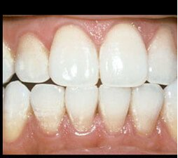
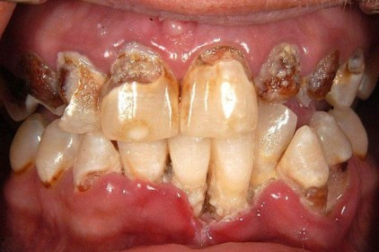
Drinking Alcohol - Down a Pathway of Pain
Even moderate drinking builds up plaque on your teeth. Plaque is a thin film that leads to cavities and gum disease
Alcohol beverages leave stains on the teeth. Colored wines and mixed drinks with dark sodas lead to permanent staining.

Slide 19
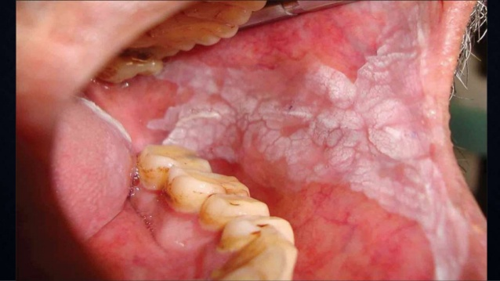
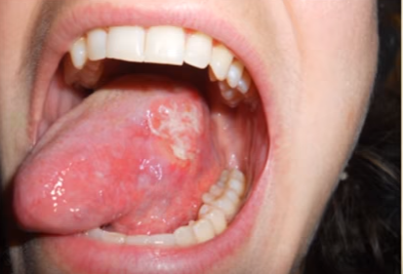
Drinking Alcohol - Down a Pathway of Pain
Even mild amounts of DAILY alcohol can lead to damage to the lining of the mouth. Even alcohol from mouthwash can lead to these white spots.
Ongoing alcohol use, chewing tobacco and smoking plus certain viral infections can bring the next stage: mouth cancer

Slide 20
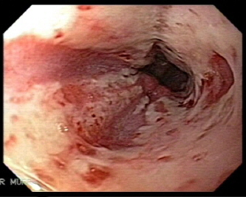
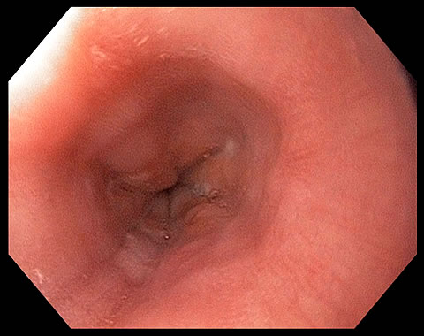
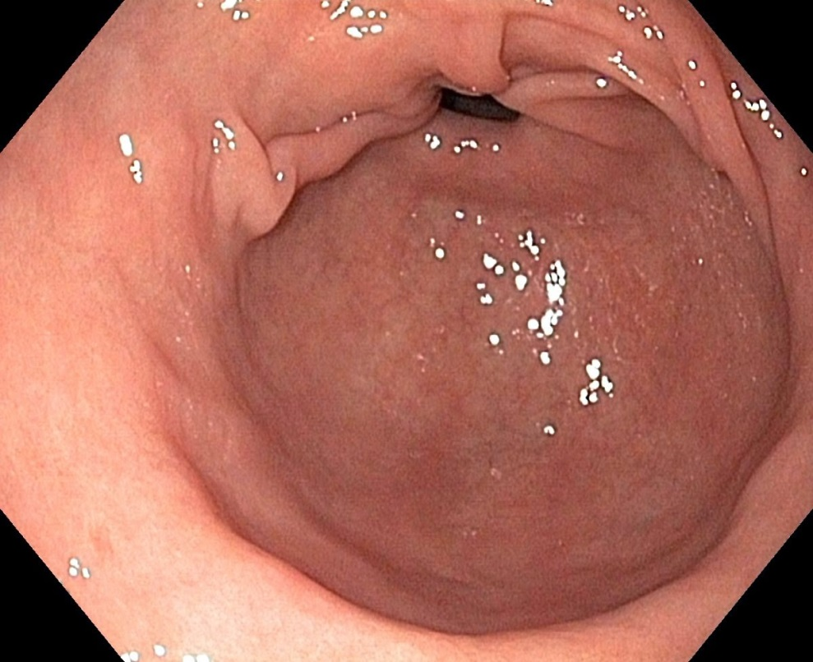
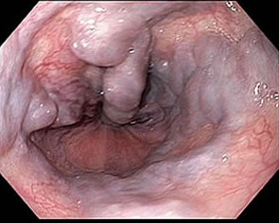
Drinking Alcohol - Down a Pathway of Pain
The esophagus gets burned with each drink.
As the liver gets inflamed and stiff, the blood backs up into big vessels in the esophagus.

Slide 21
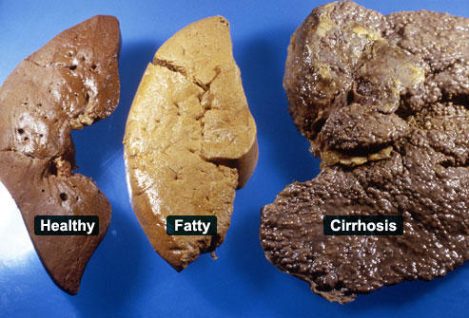
Drinking Alcohol - Down a Pathway of Pain
The constant work the liver has to do to break down and remove the toxic alcohol leaves it very inflamed and very scarred. This is called cirrhosis, or ‘hardening of the liver’. The scar leads to poor blood flow through the liver.

Slide 22
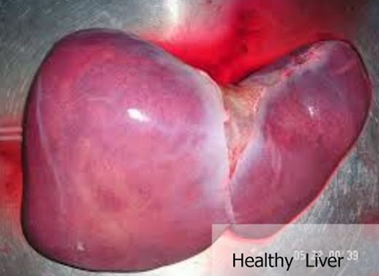
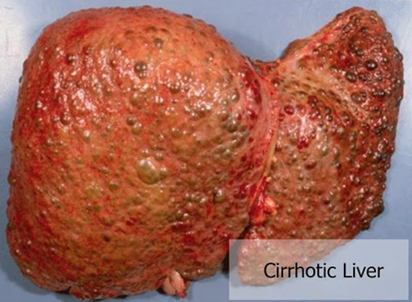
Drinking Alcohol - Down a Pathway of Pain
The constant work the liver has to do to break down and remove the toxic alcohol leaves it very inflamed and very scarred. This is called cirrhosis, or ‘hardening of the liver’. The scar leads to poor blood flow through the liver.

Slide 23
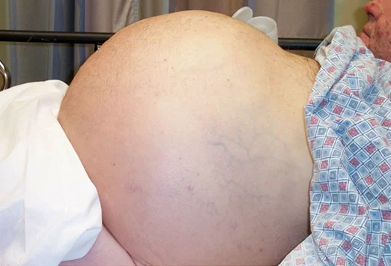
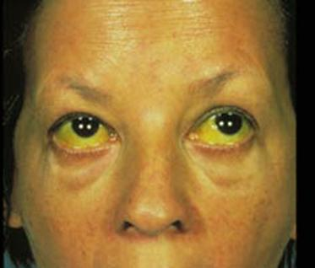
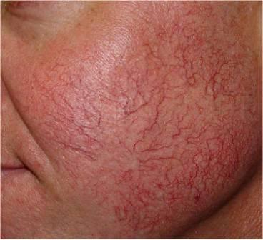
Drinking Alcohol - Down a Pathway of Pain
Blood can’t flow through the liver so backs up into the space around the bowels and the internal organs. This is called ascites.
Skin and the white of the eyes turn yellow because the liver can’t remove the yellow pigment bilirubin from your body.
3. Blood vessels swell in the skin of the face and the legs

Slide 24
Drinking Alcohol - Down a Pathway of Pain
Once the liver can no longer recover, the only hope is a liver transplant. However the few who receive a liver from another person are usually those who did not cause their own liver failure through their own poor choices.

Slide 25
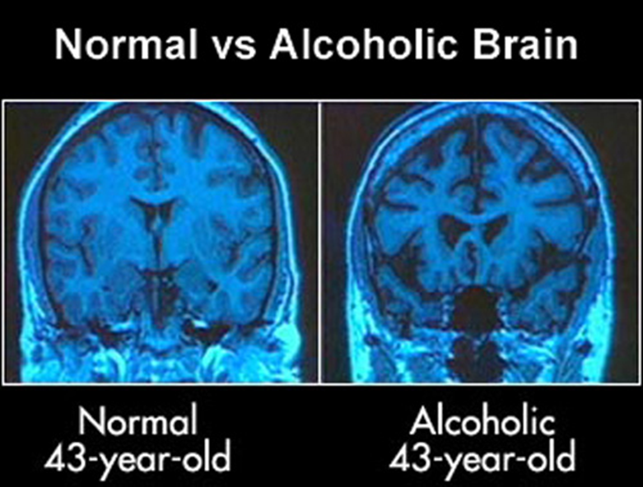
Drinking Alcohol - Down a Pathway of Pain
The brain tissue is shrinking and going away

Slide 26
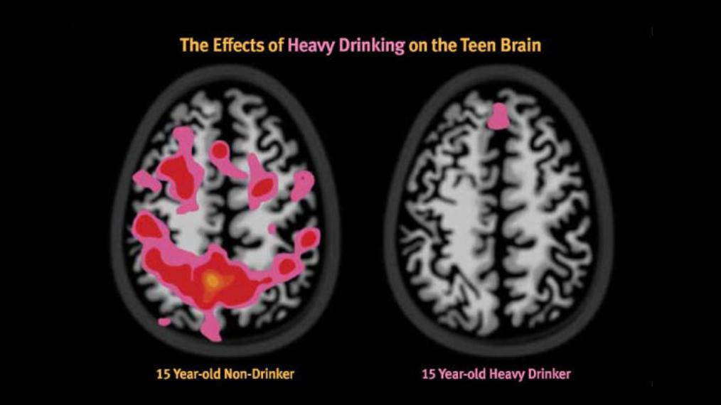
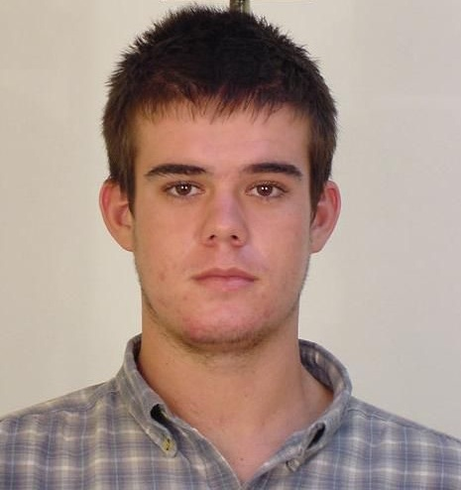
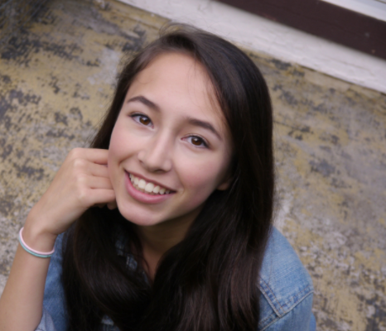
Drinking Alcohol - Down a Pathway of Pain
-Teen drinkers before and after brain scan.
-This ‘heavy drinking’ = ‘binge drinking’
-Around 1-2 drinking episodes per month with 4-5 drinks per time.

Slide 27
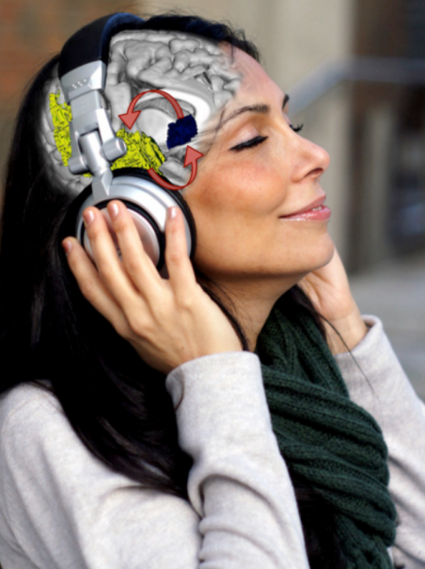
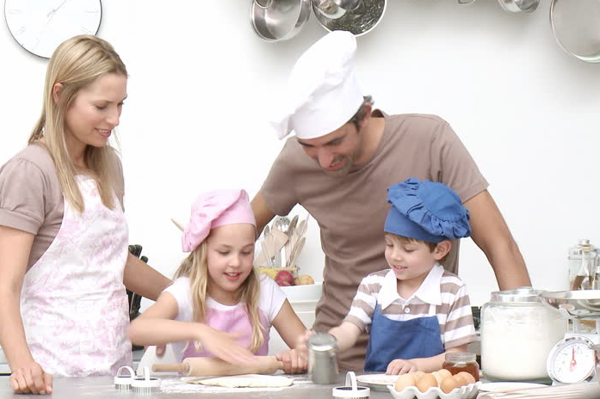
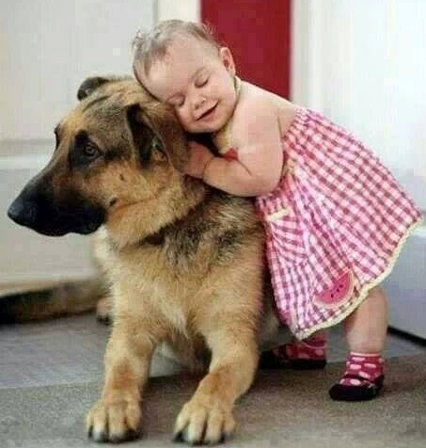
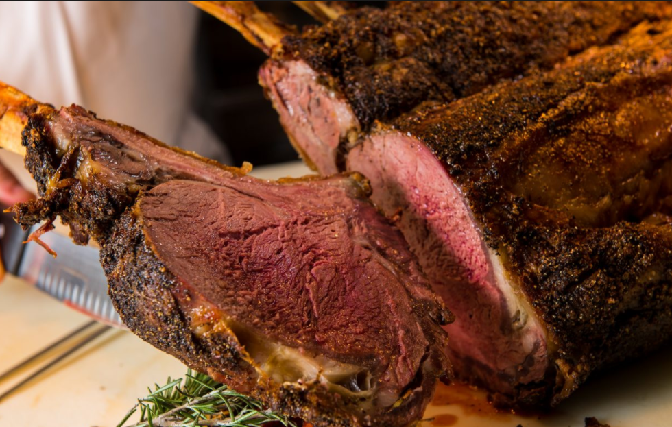
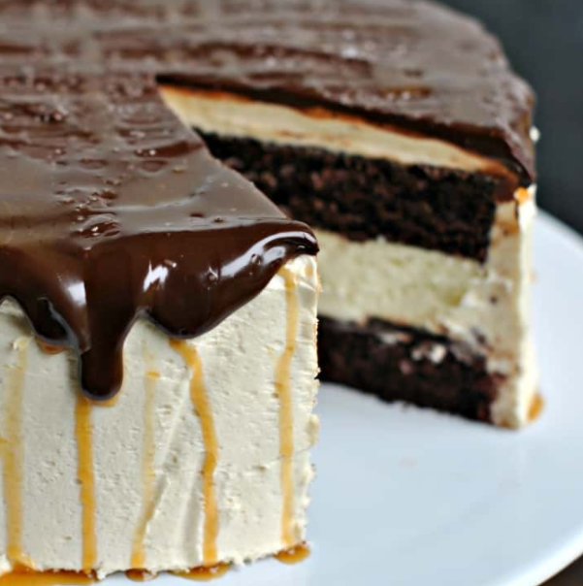
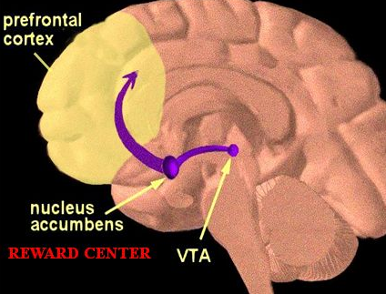
Reward center pathways
Reward center has higher activation in young people
Gives the cycle of desire, reward, feeling good, then withdrawal, craving, and then seeking for reward again
Regardless of how it is turned on, the signals and the pathway and the results are the same.

Slide 28
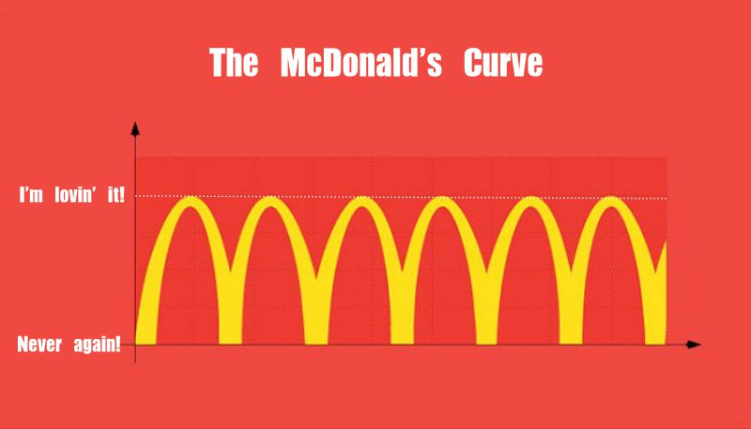
Another Reward Center

Slide 29
Karina 38 years old, from Texas, USA
weighs 285 kg (over 600 pounds!)
Look beyond the outward appearance what could produce this situation?

Slide 30
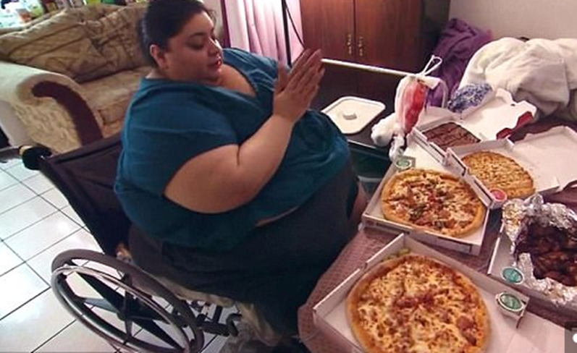
-BUT LOOK HOW SHE EATS!!!
-Can it be lack of friends or a bad group of friends?
-Self esteem must be boosted somehow

Slide 31
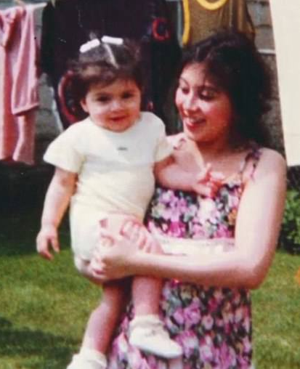
There is always a story behind the story.
-Genetics
-Medical struggles. Asthma and related treatments. Inactive, confined to oxygen tent, continual care and attention. Not able to spend time with her sister.
-Sudden loneliness due to huge medical bills and parents working long hours. Food was her comfort and friend

Slide 32
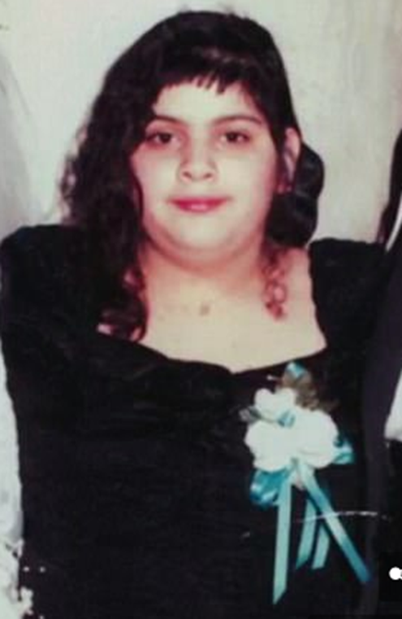
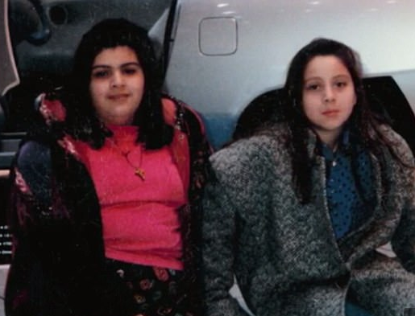
10 years old, 45kg
-Parents are Hard working!! But missing!!
-Karina is alone and feeling left out.
-Food became the replacement for security and comfort.
“Food was my Hug”

Slide 33
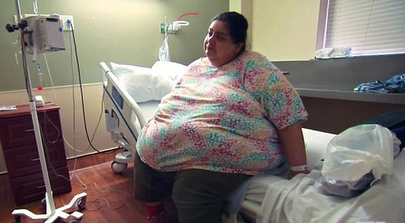
-At this point, is it helpful to point out what she is doing wrong?
-Should we tell her that she should go on a diet?
-Is it fair to expect her to be able to exercise to help lose weight?

Slide 34
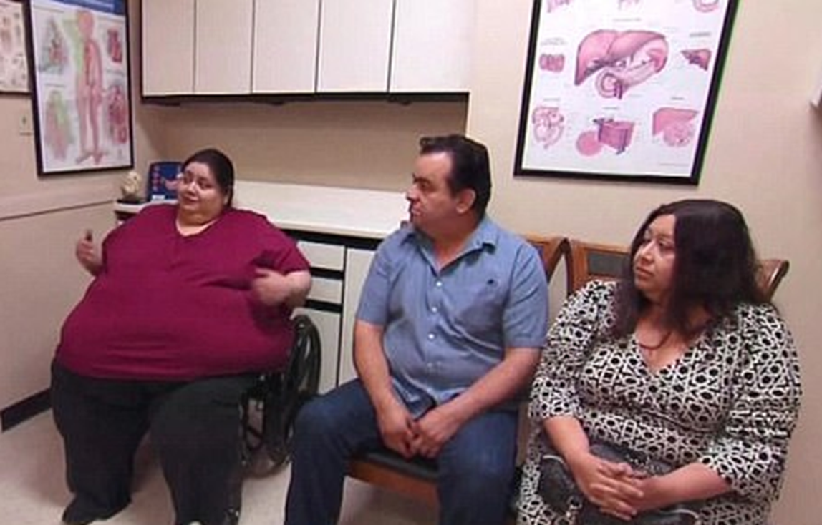
Give SYMPATHY to the patient.
Hold the those who PUT her in this situation responsible.
Create an action plan for the parents and others who keep making bad decisions for her

Slide 35
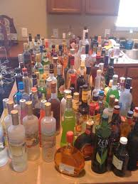
LOOK AT ALL THAT AWFUL FOOD!!

Slide 37
Social – A Pathway of Responsibility
Notes:
Dr. Knibbe talked about the pathway of pain.
I would like to talk about a parallel pathway – a pathway of responsibility – one that goes along with the knowledge of the pathway of pain.

Slide 38
All alcohol abuse (binge drinking, teen drinking, heavy drinking) is called:
Alcohol Use Disorder
(AUD)
Notes:
The pathway of pain is real, however it is the effect of long term alcohol addiction.
Disorder – “disrupt the systematic functioning or neat arrangement of” – the brain…let’s talk about the pathways of the brain and how this becomes a disorder of the brain.

Slide 39
Rat Experiment
Notes:
B.F Skinner was a psychologist who developed theories on how people or animals learn certain behaviors. Most behaviors are not learned suddenly or spontaneously. He demonstrated this with an experiment with rats. The goal was for the rat to push a lever to get some food. But the rat would not do this spontaneously. So any behavior towards the goal (such as standing on its hind legs or even just touching the lever) was rewarded with food, until the rat learned to push the lever, knowing it would receive the reward. Once this behavior is learned and reinforced, it will push the lever as many as 10 times to receive a reward.
To begin, any behavior that is even remotely close to the desired behavior is reinforced/rewarded.
As the behavior gradually moves towards the desired goal, old behaviors are no longer rewarded, only the new behaviors.
Eventually, only the final response is reinforced
This is called SHAPING – and shaping happens in ALL behaviors.

Slide 40
Shaping applies to all behaviors
Shaping teaches behaviors that we want (positive) – training a dog or teaching a child to walk or eat
However, negative behaviors are also learned by shaping--if those negative behaviors receive positive rewards (physically, socially, chemically)
Notes:
Thinking of the negative behavior of alcoholism – an individual may feel rewarded if his/her peers think it is cool that a brother or sister was drunk, if parents allow alcohol, or if he/she is allowed to attend parties with alcohol. Then the teen may feel the need to drink some alcohol his/herself. If this is positively rewarded in a social peer group, not negatively reinforced by parents and enjoyed physically, the behavior of drinking is being shaped. Soon the behavior of the teen is shaped towards drinking and if negative feedback is not strong enough, the reward center of the brain begins to chemically stimulate this negative behavior.
So shaping a brain requires certain pathways to be used consistently – we have four main pathways in our brain -

Slide 41
Pathways in the Brain
Reward Pathway – natural response to a pleasurable experience
Memory and Learning Pathway – pays particular attention to all details of pleasurable experience so it can be repeated in the future
Notes:
Our brain has many different pathways – reward, motivation, memory, control. These pathways are ‘built’ as we develop. Think of eating – we do not need to think when we eat. A 1-2 year old has to use every bit of the brain to develop the ability to eat. This pathway hasn’t been developed yet.
Each of these pathways are developed through repetitive actions and a feedback mechanism

Slide 42
Motivation/Drive Pathway: Stimulated by natural reward
Control Pathway – executive control as to whether one should seek a reward or not
Notes:
Motivation pathway – this is the personal pathway that leads people to enjoy the results from hard work.
Control pathway – this is where you make decisions and are rewarded through the decisions we make.
Each of these pathways are developed through repetitive actions and a feedback mechanism

Slide 43
Activity
Dopamine release
Pleasure
Repetitive Behavior
Notes:
How does this work in medical terminology?
The feedback mechanism is a chemical reaction in the brain.
All behaviors include this feedback mechanism that is transmitted through the neurons of the brain.
Dopamine is a neurotransmitter (between neurons) which is released after natural activities such as eating or drinking, which causes immediate feelings of pleasure.
If the activity is repeated, then dopamine is released again, and more feelings of pleasure and euphoria are produced – these feelings positively reinforce such activities.
Dopamine is believed to play an important role in the reinforcement of and motivation for repetitive actions.
The rat has pleasure when it got food, so it did the activity again, received dopamine, had pleasure and did it again.
The younger we are the less developed the pathways in our brain – “Think of your Teenager” – not that developed?! All over the place and not consistant. As we become older these pathways become a physical part of our brain – thus the phrase “you can’t teach an old dog new tricks”. That is because: …..

Slide 44
The behavioral patterns we repeat most often are literally etched into our neural pathways.
Notes:
For the kids – this is like cookies on your computer – makes your computer faster because it doesn’t have to recall the whole thing.
It is easier to cut off your arm than it is to fix the physical pathway of the brain.

Slide 45
Pathways of the brain
Notes:
Now your brain is physically set. This is why I didn’t like neuro surgery…I did neuro surgery for about a year as an operating room nurse and didn’t like it at all. Once you see this brain here – if the doctor touches it just wrong while going after the tumor – the persons PHYSICAL pathways are messed up and they have no idea how to eat when they wake up.
This doesn’t work for me – I would rather understand exactly what happens when you touch something and try to fix it which is why I went to cardiac surgery.

Slide 46
Pathways of the brain
As the reward center continually receives high amounts of dopamine the control center diminishes
You actually lose the ‘executive function’ of your brain – the ability to make ‘common sense’ judgements
The brain begins to rely on impulse decision making
Control center
Reward center
Reward center
Control center
Normal Brain
Addicted Brain
Notes:
This development of the physical pathway and the reward associated with it is the heart of understanding addiction.
We can show you many brain scan which show the decrease of blood flow and neurotransmission in the frontal lobe. This poor functioning makes a person feel the sense of ‘loss of control’. As this process continues you end up with new neural pathways that PHYSICALLY are imbedded in your brain.
As the reward center continually receives high amounts of dopamine the control center diminishes
You actually lose the ‘executive function’ of your brain – the ability to make ‘common sense’ judgements
The brain begins to rely on impulse decision making
Look a shoes and give example of shoe shopping. Give example of cleaning.
And now you have a cycle that physically changes your brain that is not based in common sense at all!!! You will continually do things that defy common sense – you do them because you have been rewarded for them and now this behavior is more pleasurable than ‘common sense’.

Slide 47
What can we learn from this?
All behavior that is rewarded and repeated will change your brain – this will form habits and eventually addictions (shaping).
“Nerve cells that fire together will wire together.”
Notes:
You can’t just say that you will drink during high school or college years and then you will stop – drinking often and repetitively will have changed your brain. Just “stopping” is not likely and nearly impossible.
Long after an addict has quit ‘using’ these sensitized pathways remain. This explains why alcoholics who have been sober for many years may still suffer from strong cravings when they walk into a bar.
So if shaping your brain is important – how do we do it? What are the factors that contribute to ending up with behaviors that repeated despite common sense telling you not to do it?
Two factors…

Slide 48
Factors that Shape Addiction
Genetics
Contributing Events or Pressures
Notes:
Two main factors:
Genetics – the patter we were born with that tells us who we are or are going to be.
You may have heard this as ‘hardwiring’ – ‘personality’ – this is important but let’s look at it realistically. Is there an ‘alcohol gene’? NO
There are genes that make you physical react to alcohol differently and therefore avoid it. This would be like asking if there is a ‘shopping gene’ for those addicted to shopping or a ‘cleaning gene’ for those addicted to cleaning. We would all say “No” – it is a behavior.
While genetics cannot be ignored – they also cannot be blamed. Regardless of your genetic make up – if you don’t drink alcohol you will not be addicted to it. Regardless of your genetic make up – if you never see pornography you will never be addicted to it.
Yet like any other disease – if you family has a history of it then you should be doubly careful. So the genetic factor is much more about behaviors that you have seen while growing up and how that has SHAPED your brain.
Why is this?

Slide 49
Factors that Shape Addiction 2. Contributing Factors
These are factors that shape behaviors.
Notes:
Parents
Families/social groups
Access
What contributes to alcoholism within in a community? Alcoholism defined as ‘the need to drink socially as often as possible’

Slide 50
Factors that Shape Addiction 2. Contributing Factors
Notes:
My job is dependent on people making bad choices. I want to make sure what everyone in Grand Rapids:
has a deep fryer,
make sure every meal is balance by having it full of deep fried food with saturated fats,
limit all green leafy things
try to not eat vegetables,
drink a lot of coke and beer,
eat all things processed,
sit at home on a computer and do not exercise,
and please don’t see a doctor until you have chest pain.
As parent it would be considered irresponsible to cook this way for you children. As a community it would irresponsible to have every function promoting the lack of healthy eating. It would be irresponsible of a school to promote and encourage a life behind screens with no activity. The best way to diminish this influence is to not have access to it.
We recognize the contributing factors of cardiac disease regardless of our genetics.

Slide 51
Notes:
has a deep fryer,
make sure every meal is balance by having it full of deep fried food with saturated fats,
drink a lot of coke and beer
limit all green leafy things
try to not eat vegetables,
eat all things processed,
sit at home on a computer and do not exercise,
and please don’t see a doctor until you have chest pain.

Slide 52
Notes:
drink a lot of coke and beer

Slide 53
Notes:
limit all green leafy things
try to not eat vegetables,
eat all things processed,
sit at home on a computer and do not exercise,
and please don’t see a doctor until you have chest pain.

Slide 54
Notes:
eat all things processed,

Slide 55
Notes:
sit at home on a computer and do not exercise,

Slide 56
Notes:
and please don’t see a doctor until you have chest pain.

Slide 57
Notes:
Let’s do this with the contributing factors of alcoholism:
If we want to develop the reward center to have a positive feedback/popularity from binge drinking/social drinking all the time we would:
Make sure parents don’t stop their children from drinking

Slide 58
Notes:
Make sure that they have ample opportunity to drink

Slide 59
Notes:
Give them the space and time – open your house/yard/farm for a party

Slide 60
Notes:
Make sure they have the beer – preferable the beer that they like the most

Slide 61
Notes:
Make them popular – these kids don’t get in trouble, get no negative authoritative intervention,
The subgroups within a community become more popular by promoting/helping this behavior

Slide 62
Notes:
Make sure that this isn’t a problem until someone is in a coma/serious car accident
This naturally leads to ask – what are we personally accountable for?

Slide 63
Common sense would indicate that doing any of these would reinforce and promote a negative behavior.
Rather, we should ask : How can we prevent these behaviors – the habits and addictions which are destructive to our body and soul?
Notes:
Cardiac nurses would be considered irresponsible to promote these contributing factors to heart disease. Our whole team works to promote the opposite! And we feel good about it – promoting behaviors that, if followed well, would reduce our cardiac surgery!
Shouldn't we do the same with contributing factors to AUD – it would be irresponsible to promote these behaviors – rather we should do the opposite!

Slide 64
The Pathway of Responsibility
Effectively deal with peer pressure
Learn about the consequences
Choose your friends carefully
Notes:
Choose your friends carefully - simply do what you can to avoid people who are using. Easy access to drugs or alcohol is among the top risk factors for substance abuse. Behavioral addictions count, too. . If you always see it, you will get used to it and be much more likely to start drinking.
Learn about the consequences of drug use. It may seem obvious that using alcohol and drugs raises your risk of losing your job, dropping out of school, participating in risky behavior and developing substance-induced mental disorders. But the truth is that simply understanding all the ways that drug abuse can be harmful has been shown to reduce drug-taking in adolescents, NIDA reports.
Effectively deal with peer pressure. The biggest reason teens start using drugs is because their friends utilize peer pressure. No one likes to be left out, and teens (and yes, some adults, too) find themselves doing things they normally wouldn’t do, just to fit in. In these cases, you need to either find a better group of friends that won’t pressure you into doing harmful things, or you need to find a good way to say no. Teens should prepare a good excuse or plan ahead of time, to keep from giving into tempting situations. Associating with people who abuse drugs or alcohol or who have accepting attitudes toward substance abuse increases the likelihood of drug abuse.
Just Say No – The most obvious way to prevent addiction is to avoid drugs and alcohol. But it’s not always that simple. Because human beings are wired for pleasure-seeking and will always pursue quick relief from pain, the “just say no” approach has failed in the past and will continue to be only a partial answer to addiction prevention.
(Daniel and his three friends, also, not bowing before Nebuchadnezzar’s image.

Slide 65
Effectively deal with peer pressure
The reward of social acceptance can be as much of a dopamine releaser as the alcohol itself.
Parents who allow their children to participate in social drinking are providing two powerful contributors to addiction
Notes:
Two powerful contributors – dopamine release from the reward of social acceptance and dopamine release from the alcohol
Parent peer pressure – status pressure - weddings

Slide 66
Remember: once the reward pathway has been established in the brain, the brain is physically changed.
It has changed who you are – it will take a powerful control center and motivational pathway to be able to break with the habit, or worse, the addiction.
Notes:
Example – smoking. How many people that quit smoking, start up again when around other smokers – the pathway to the reward centre is still present. Statistics?

Slide 67
The Pathway of Responsibility
Avoid starting young
Effectively deal with peer pressure
Learn about the consequences
Choose your friends carefully
Notes:
Avoid starting young. Those who start drinking or using drugs in their early teens are more apt to develop an addiction later in life, according to NIDA. Which doesn’t mean that steering clear of substance use isn’t important for older people, too. According to the director of NIDA, Nora D. Volkow, M.D., in recent years there’s been an upswing in people 50 and 59 abusing both illicit and prescription drugs. Delaying alcohol use until age 21 or later may reduce the risk of alcohol-related problems in adulthood.

Slide 68
Apathy
“Everybody does it”
“Not my problem”
“I don’t care”
“I can’t help it”
The greatest enemy of solving addictive behavior
Notes:
What happens in a community when Apathy becomes a ‘circuit’? Addictive behaviors need to be discussed and understood – the full extent of them – apathy is a byproduct of addictive behaviors.

Slide 69
Some may care about their own addictions or about a social problem within the community but…
There is nothing “we” can do
There is nothing “they” can do
So, despite concern, a feeling of helplessness will make you cynical or apathetic
Notes:
This is different than blatant apathy. For those who are not drinking (parents, teachers, loved ones) they may feel there is no way to change the situation or help – maybe it has spiraled out of control – and there’s nothing “they”, the drinkers can do, they are trapped in a lifestyle. So feeling unable to change anything or help will cause one to fall into apathy from a lack of ability to change, not a lack of caring about the problem.
Apathy, as a behavior, extends to the whole of a community:
Home
Family
School
Church
Doctrine
Catechism
Etc.

Slide 70
Community Help
Build Strong Relationships – A strong support system can be a strong protective factor against addiction. Whether you turn to friends, family, or the community, finding someone you can lean on can help you work through stress and other emotions without a chemical escape.
Set and Work Toward Goals – People who set realistic goals and actively work toward them are less likely to get sidetracked by drugs or alcohol than people who feel they are not achieving their goals or don’t have anything to work toward.
Accept friends, peers, and relations who don’t drink. Don’t shame them.
Notes:
Care about who you associate with and build strong relationships with them. Talk about the problems and set goals for them.
Give the example of the cell phone contract.
Talk about shame:
Shame being the easiest way to ensure addictive behavior becomes popular and engrained in a culture. It doesn’t take into account the destructive nature of addiction, the physical, mental pain, the changes of the brain that leads to social behavioral problems. The pathway of shame leads to SILENCE.
Think of the kid who is fat shamed in school, the kids who don’t come to the party, the parents who don’t allow drinking – do we shame them into silence?

Slide 71
Go to where the silence is
and say something.
Notes:
If so – what are we supposed to say?

Slide 72
Cotton Mather, (Puritan; 1663-1728) in his book, A Family Well Ordered says:

Slide 73
Cotton Mather, Puritan (1663-1728) says:
“I beseech you, parents, interpose your authority to stop and check the carriage of your children when they are running into the paths of the destroyer. Gratify them with rewards of well doing when they do well, but do not let them be gratified with every ungodly vanity that their vain minds may be set upon.
Keep a strict inspection upon their conversations; examine how they spend their time; examine what company they keep; examine whether they take any bad courses.”

Slide 74
Cotton Mather, Puritan (1663-1728) says:
“Let your charge be from Proverbs 9:6: ‘Forsake the foolish and live.’ Charge them to avoid the snares of evil company; terrify them with warnings of those deadly snares.
Often repeat this charge unto them; if there is any vicious company, shun them as you would the plague or the devil.
Often say, ‘My son, if sinners entice thee, consent thou not.’ Often say, ‘My child, walk with the wise and thou shalt be wise, but a companion of fools shall be destroyed.’”
Notes:
-If we allow our children to drink, are we not neglecting their soul and their body?

Slide 75
Questions?
Notes:
Questions?

